Slide 1
Topological Cell Signal Clustering in the ATLAS Calorimeters (An Introduction)
Peter Loch
University of Arizona
Tucson, Arizona
USA
with a lot of input from
Sven Menke
Max Planck Institut für Physik (MPI)
Munich
Germany

Slide 2
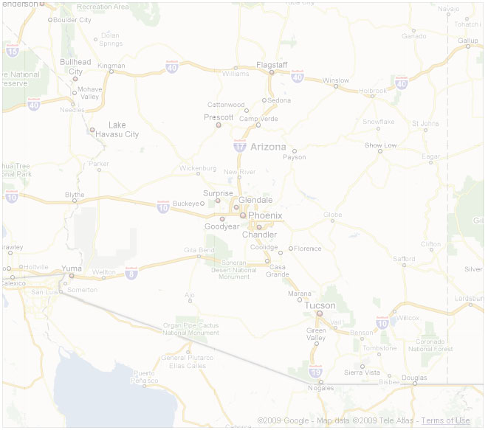
Roadmap
(1) Topocluster formation and noise suppression
Clustering rules
Cell level noise suppression
(2) Local hadronic calibration
Topocluster classification
Response calibration
Signal efficiency corrections
(3) Topocluster performance in data and MC
No/low pile-up performance (2010 data)
Effect of high pile-up environments (2011/2012 data)
(4) Preparations for higher intensities and energies – LHC 2015 and beyond
Conceptual issues and first performance expectations
Extensions of calibration models and local pile-up suppression
(5) Projects for HFSF 2013 and follow-up
Pile-up configurations and data sets
Understanding important topocluster features in new environment – list of variables to look at, sensitivities to explore…
Studies involving cells – infrastructure and first suggestions

Slide 3
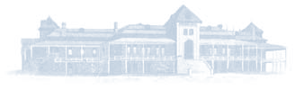
TopoCluster Formation and Noise Suppression

Slide 4
Clustering Motivations & Rules (1)
Why dynamic calorimeter cell signal clustering
Noise suppression
Extract the (small) fraction of cells actually contributing to the collision signals – no static projection like calorimeter cell towers
Allow local and least biased basic signal calibration
Attempt to reconstruct a three-dimensional image of a particle shower (or overlapping showers) in the calorimeter
Shape of reconstructed energy blob provides hint for electromagnetic or hadronic energy deposit in non-compensating calorimeter – apply corresponding calibrations cluster-by-cluster
Reconstruct transverse momentum flow pattern
Application in jet substructure reconstruction, event shapes, missing transverse momentum without enforcing a specific geometrical view like e.g. calorimeter cell towers
Useful for particle ID
E.g., tau reconstruction in ATLAS – neutral pion signal could be separated from charged pion signal with some efficiency
Notes:
Noise suppression in highly granular ATLAS calorimeters
Only a fraction of all calorimeter cell signals are from physics objects – exact quantity depends on final state
Adding cells without “true” signal in physics object reconstruction increases signal fluctuations for the reconstructed object and thus reduces resolution
Need (mostly) signal definition with high efficiency for true signal to survive while irrelevant signals to be suppressed
Local signal scales in non-compensating calorimeters
Classical approach (e.g. Tevatron) – apply all calibrations and corrections to fully reconstructed objects like particles and jets – leads to large corrections and scales to be applied
Inter-calibration between signals from various calorimeter regions, particle types and particle energies can be typically wrong up to 60% or more – can be a problem for internal pT scales in recursive recombination jet algorithms, jet substructure, and global event quantities like missing transverse energy and event shapes (mostly with respect to resolution and signal stability)
Can be addressed by local calibration not biased with respect to a given physics object type

Slide 5
Clustering Motivations & Rules (2)
Guidelines for clustering algorithm
Follow significant and connected signal patterns in the calorimeter cells
Ideally trace the correlations between cell signals introduced by individual or overlapping electromagnetic and/or hadronic showers in an attempt to reconstruct isolated and merged particle cascades
Basic scale for measuring significance in each cell is its noise – underlying signal fluctuations introduced by elementary readout and signal processing, and the pile-up signal history.
Connect cells in three dimensions to form localized “energy blobs” in the calorimeter (topological nearest-neighbor clustering)
Let cell signal and its environment define cell contribution
Small signals in close proximity to large signals are likely from true energy deposits – even if the (isolated) signal significance is low
Large signals – seeds, smaller signals – control growth around seeds
Control cluster growth
Important (transverse) momentum flow patterns relevant for any final state should be preserved with high sensitivity

Slide 6
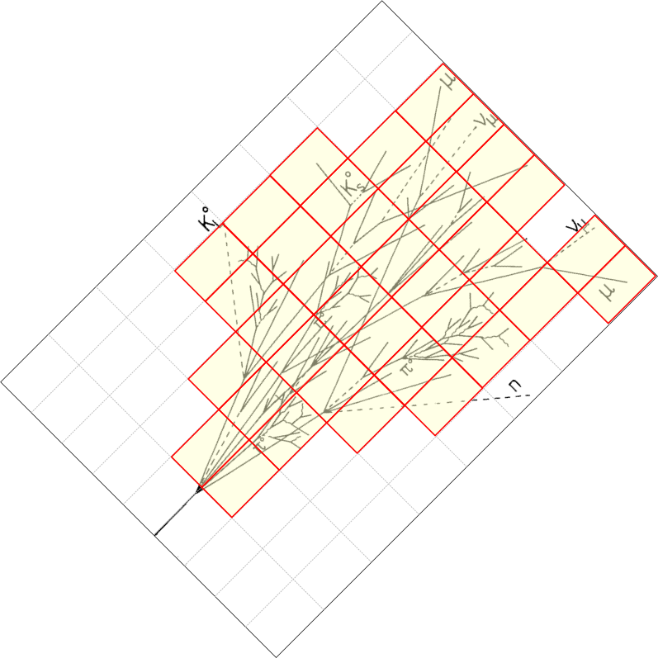
Topological Cell Cluster Implementation
Collect cell into energy “blobs”
Idea is to collect all cell signals belonging to a given particle into one cluster of cells
Basically reconstruct the shower for each particle entering the calorimeter
Needs algorithm to form energy blobs at the location of the shower signal in the calorimeter
Follow the shower-induced cell signal correlations
Extract most significant signal from all calorimeter cells
Cluster formation uses signal significance as guidance
Not the total signal – noise changes from calorimeter region to calorimeter region
Implicit noise suppression in cluster formation
Cluster signals should include least amount of noise

Slide 7
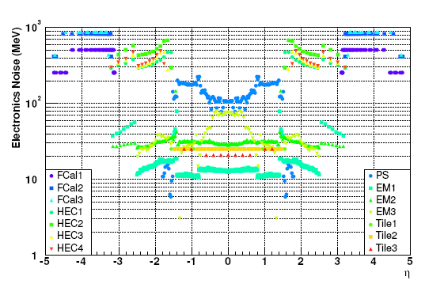
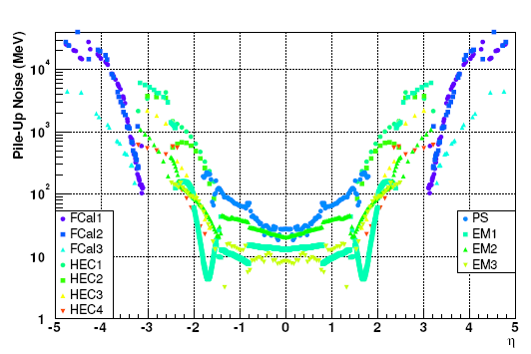
Topological Cell Cluster Implementation
Collect cell into energy “blobs”
Idea is to collect all cell signals belonging to a given particle into one cluster of cells
Basically reconstruct the shower for each particle entering the calorimeter
Needs algorithm to form energy blobs at the location of the shower signal in the calorimeter
Follow the shower-induced cell signal correlations
Extract most significant signal from all calorimeter cells
Cluster formation uses signal significance as guidance
Not the total signal – noise changes from calorimeter region to calorimeter region
Implicit noise suppression in cluster formation
Cluster signals should include least amount of noise
Electronic Noise in Calorimeter Cells
S. Menke, ATLAS Physics Workshop 07/2005
Pile-up Noise in Calorimeter Cells
S. Menke, ATLAS Physics Workshop 07/2005

Slide 8
ATLAS Topological Cell Clustering
Cluster seeding
Defined by signal significance above primary threshold
Cells above this threshold can seed cluster
Cluster growth
Defined by signal significance above secondary threshold
Cells neighbouring seeds with significance above this threshold drive cluster growths
Cluster signal
Defined by cells with significance above basic threshold
Cells to be considered in cluster energy sums
Use of negative signal cells
Thresholds are considered for the absolute (unsigned) signal magnitude
Large negative signals can seed and grow clusters
Parameters for each stage optimized with testbeam data
Experimental single pion shower shapes guide cluster algorithm develpoment
Clean tuning reference!
Famous “4/2/0” clustering in ATLAS

Slide 9
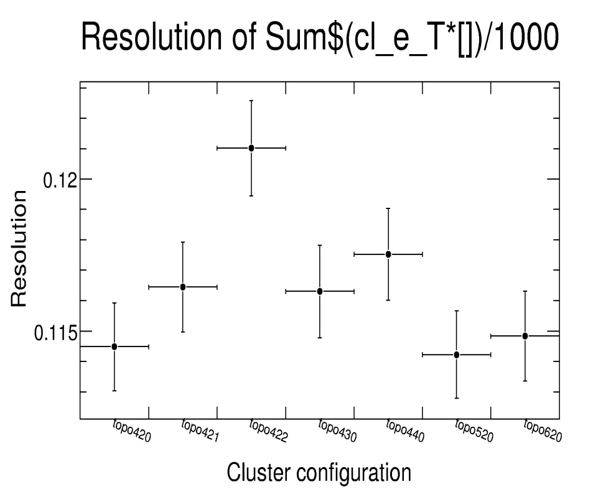
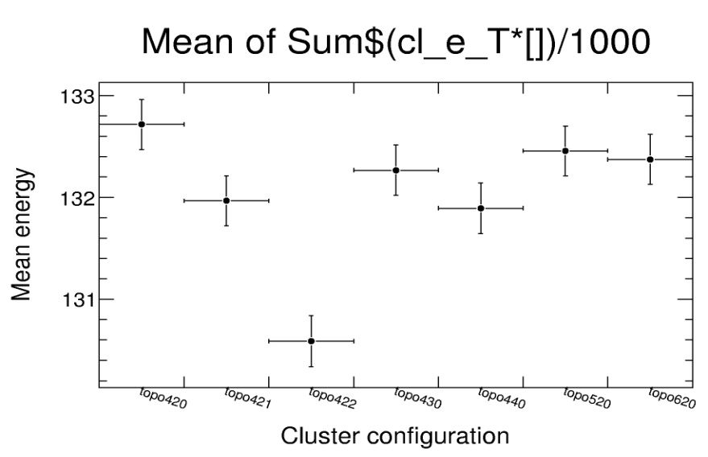
ATLAS Topological Cell Clustering
Cluster seeding
Defined by signal significance above primary threshold
Cells above this threshold can seed cluster
Cluster growth control
Defined by signal significance above secondary threshold
Cells neighbouring seeds with significance above this threshold drive cluster growths
Cluster signal
Defined by cells with significance above basic threshold
Cells to be considered in cluster energy sums
Use of negative signal cells
Thresholds are considered for the absolute (unsigned) signal magnitude
Large negative signals can seed and grow clusters
Parameters for each stage optimized with testbeam data
Experimental single pion shower shapes guide cluster algorithm develpoment
Clean tuning reference!
Resolution of Sum E_{clus}
180 GeV pions
↑ P
↑ N
↑ S
Mean of Sum E_{clus}
↑ S
↑ N
↑ P

Slide 10
Clustering Algorithms
Find cell with most significant seed over primary threshold S
Collect all cells with significance above basic threshold P
Consider neighbours in three dimensions
Defined by (partly) shared area, (partly) shared edge, or shared corner point
E.g., 26 neighbours for perfectly cubed volumes of equal size
Neighbours can be in other calorimeter regions or even other calorimeter sub-systems
Granularity change to be considered in neighbouring definition
For all cells neighbouring seeds with signal significance above secondary threshold N, collect neighbours of neighbours if their signal significance is above P
Same rules as for collection around primary seed
Continue until cluster does not grow anymore
Automatically generate “guard ring” of small signal cells at cluster margin
In three dimensions, of course
Take next not yet used seed cell and collect next cluster

Slide 11
Clustering

Slide 12
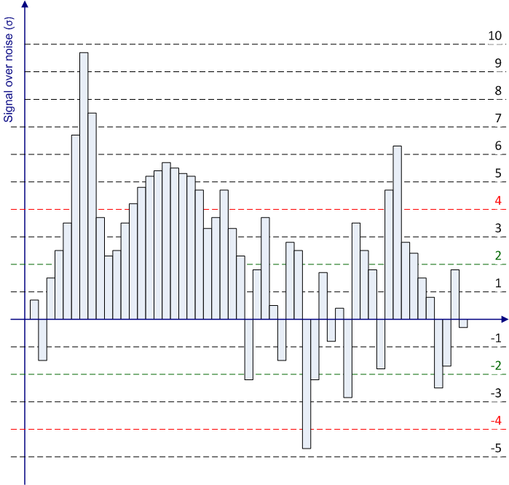
Clustering Example

Slide 13
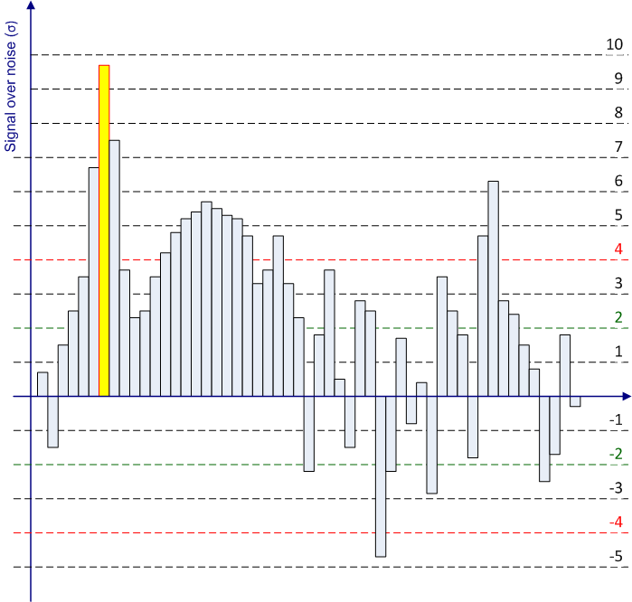
Clustering Example

Slide 14
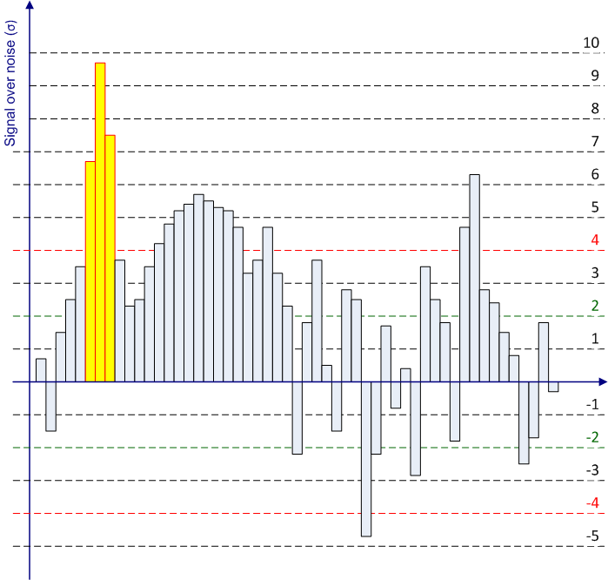
Clustering Example

Slide 15

Clustering Example

Slide 16
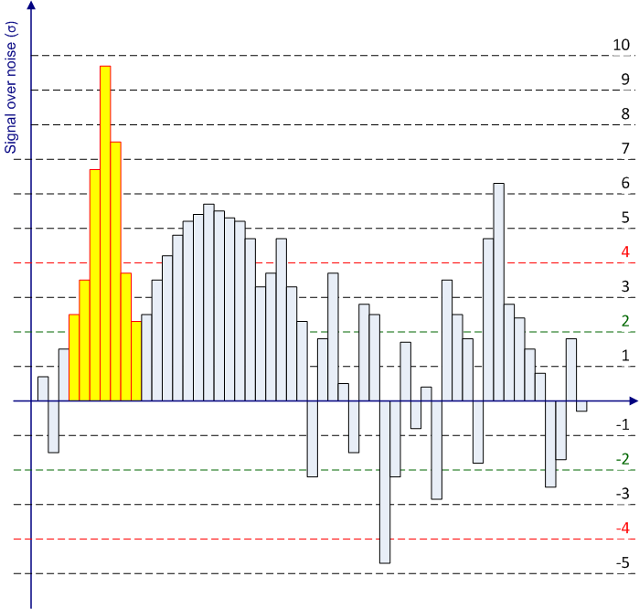
Clustering Example

Slide 17
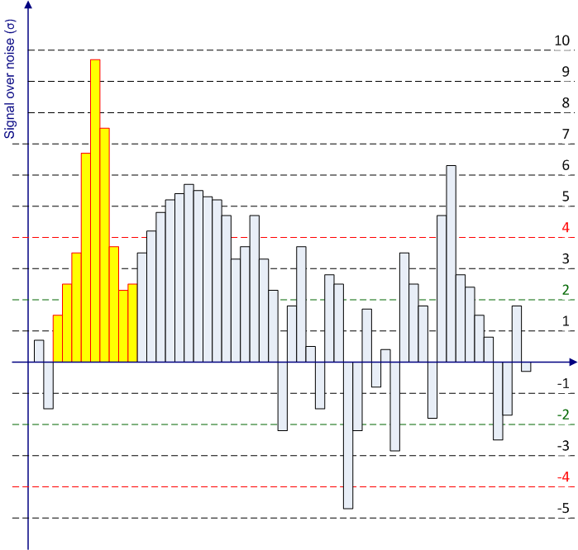
Clustering Example

Slide 18
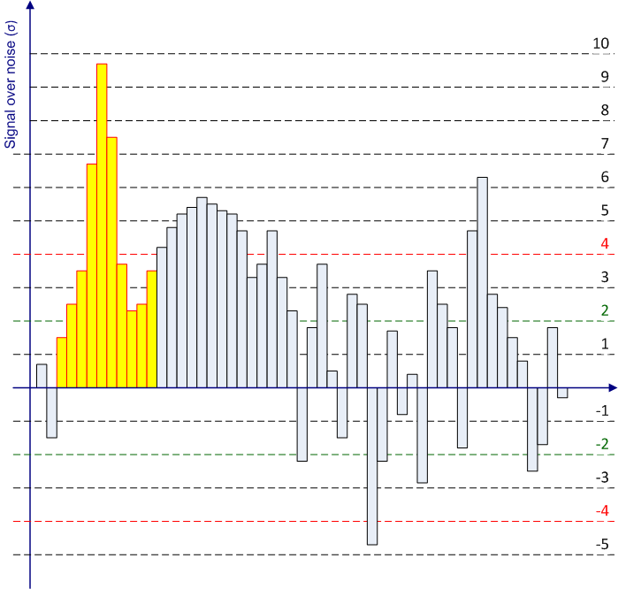
Clustering Example

Slide 19
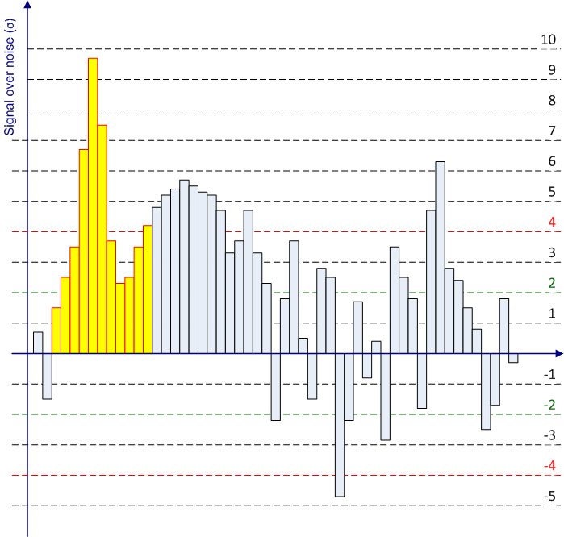
Clustering Example

Slide 20
Clustering Example

Slide 21

Clustering Example

Slide 22

Clustering Example

Slide 23

Clustering Example

Slide 24
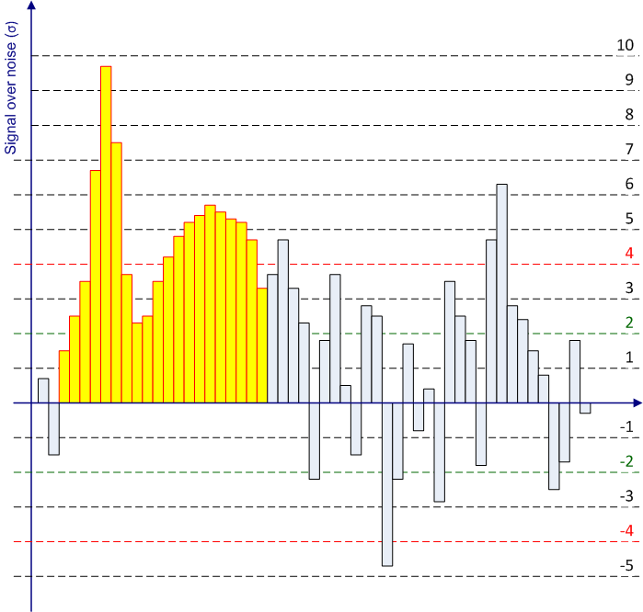
Clustering Example

Slide 25
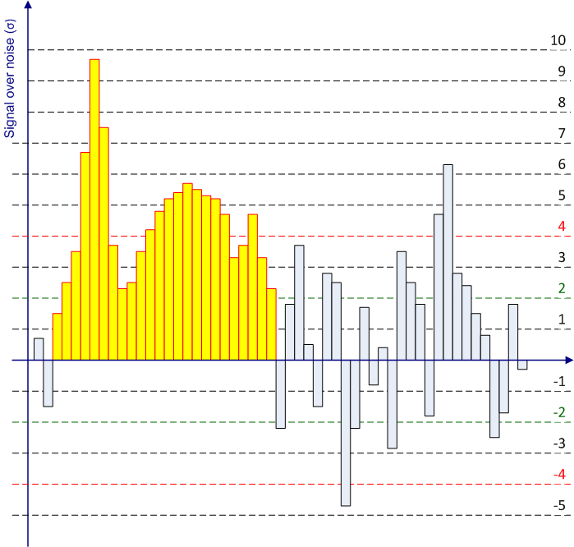
Clustering Example

Slide 26

Clustering Example

Slide 27

Clustering Example

Slide 28

Clustering Example

Slide 29
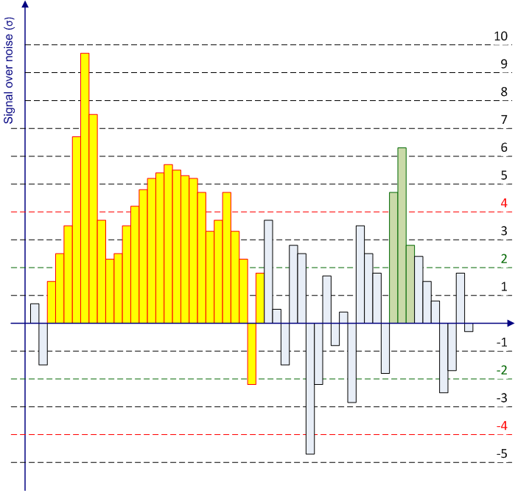
Clustering Example

Slide 30
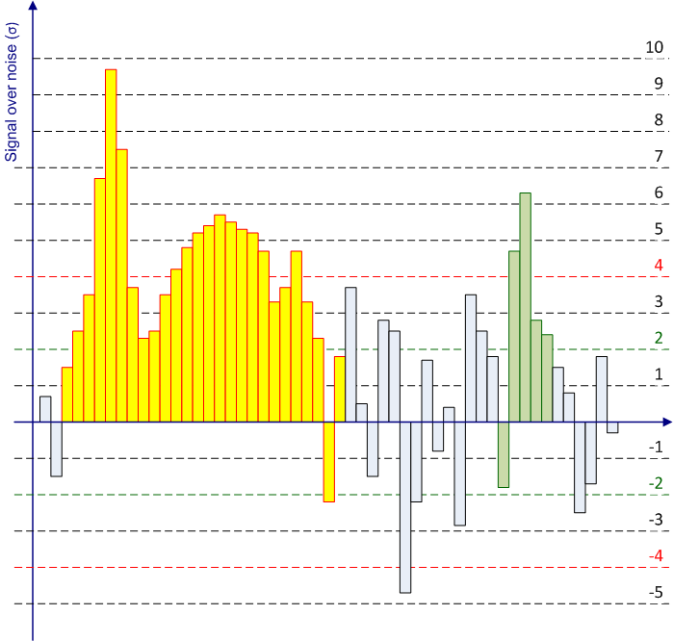
Clustering Example

Slide 31

Clustering Example

Slide 32

Clustering Example

Slide 33

Clustering Example

Slide 34

Clustering Example

Slide 35

Clustering Example

Slide 36
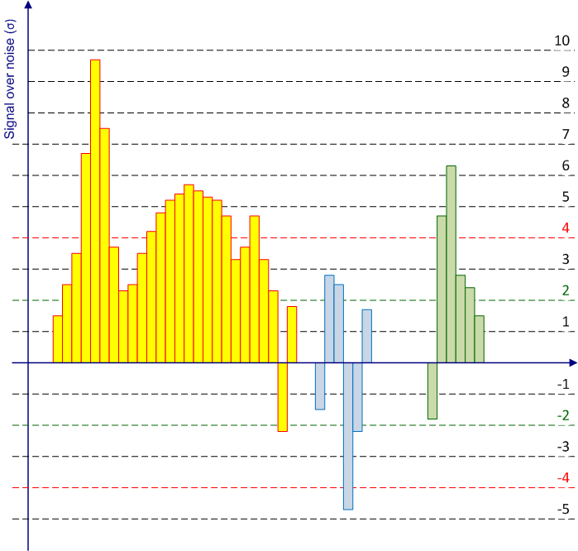
Clustering Example

Slide 37
Effect Of Strict Nearest Neighbour Approach
Large topologically connected regions in calorimeter can lead to large cell clusters
Lost particle flow structure can introduce problems for jets
Infrared safety, in particular
Need to refine the clustering algorithm
Try to match single particle shower shapes better
Splitting the clusters
Examine spatial cluster signal structure – find local signal maxima
“hill and valley” structural analysis in three dimensions
Split cluster between two maxima
In three dimensions, of course!
Share energy of cells in signal valleys
Needs sharing rules – introduces “geometrically” weighted cell energy contribution to cluster signal
Introduces new tunable parameter
Local signal maximum threshold is defined in units of energy, not significance!

Slide 38
Cluster Splitting

Slide 39
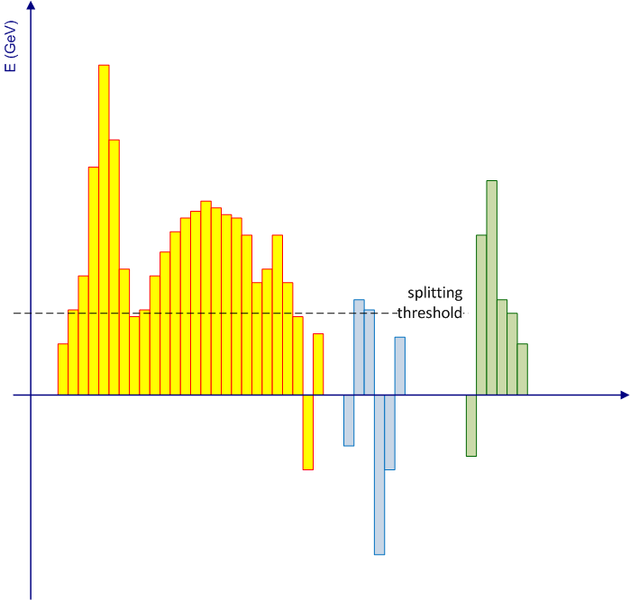
Cluster Splitting

Slide 40
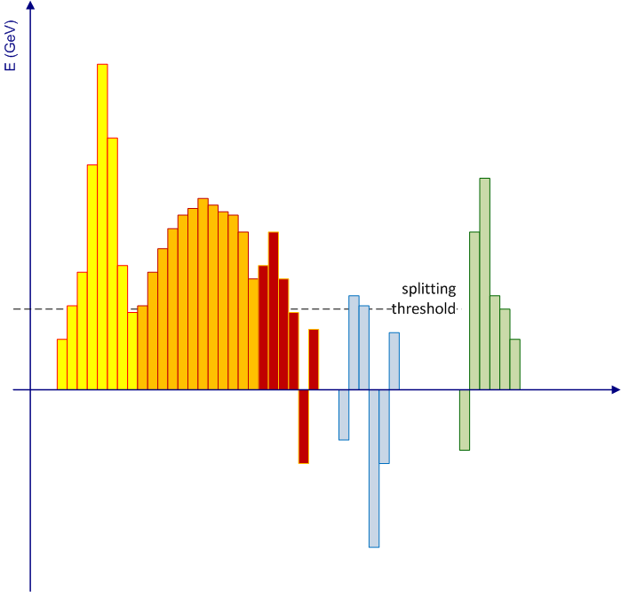
Cluster Splitting

Slide 41
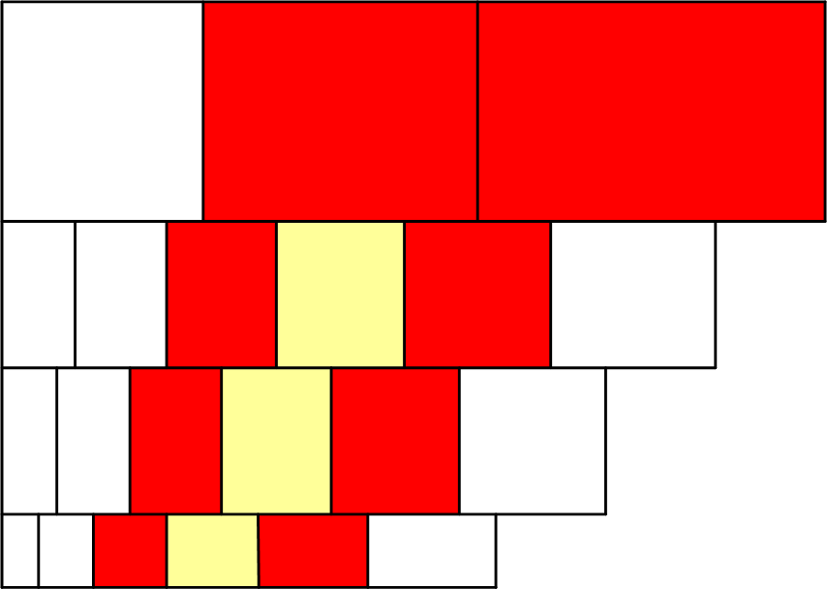
Splitting & Cell Energy Sharing
Splitting technique
Guided by finest calorimeter granularity
Typically in electromagnetic calorimeter
Allows to split larger cell signals without signal valley
Typically in hadronic calorimeters

Slide 42
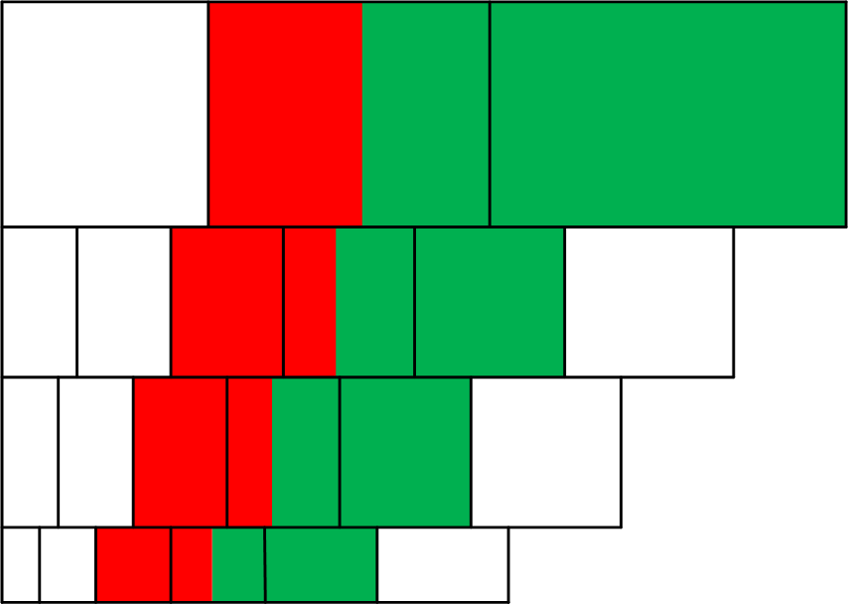
Splitting & Cell Energy Sharing
Splitting technique
Guided by finest calorimeter granularity
Typically in electromagnetic calorimeter
Allows to split larger cell signals without signal valley
Typically in hadronic calorimeters

Slide 43
Single Particle Clusters

Slide 44
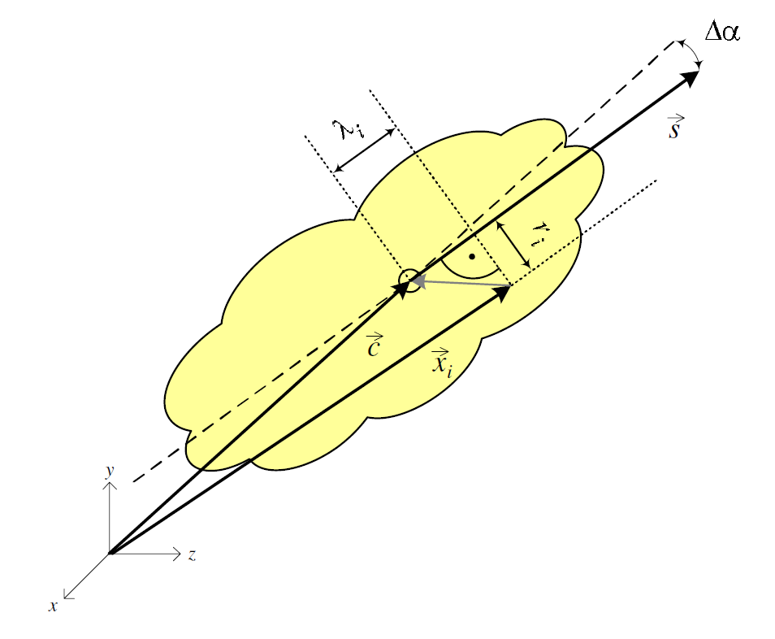
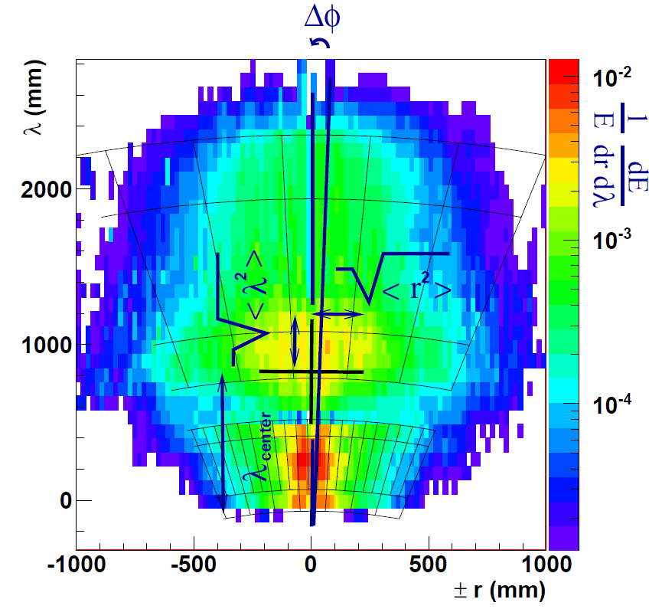
Cluster Shapes
Clusters have shapes
Geometrical moments and sizes
Lateral and longitudinal
Tilt of principal axis
With respect to direction extrapolation from primary vertex (magnetic field!)
Density and compactness measures
Cluster energy distribution in cells
Energy sharing between calorimeter segments and modules
Shower structures
Useful for cluster calibration
Exploit shape sensitivity to shower character
Hadronic versus electromagnetic

Slide 45
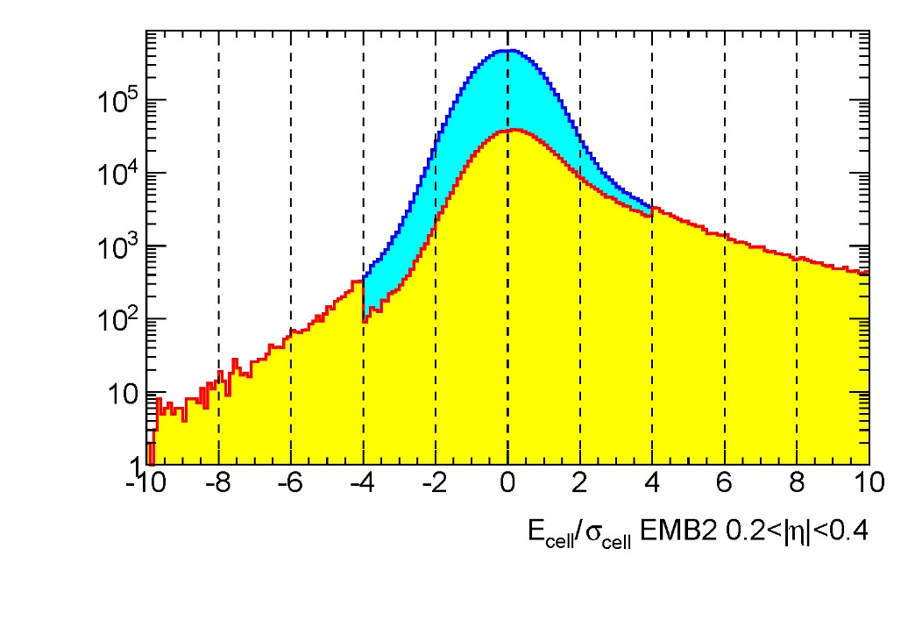
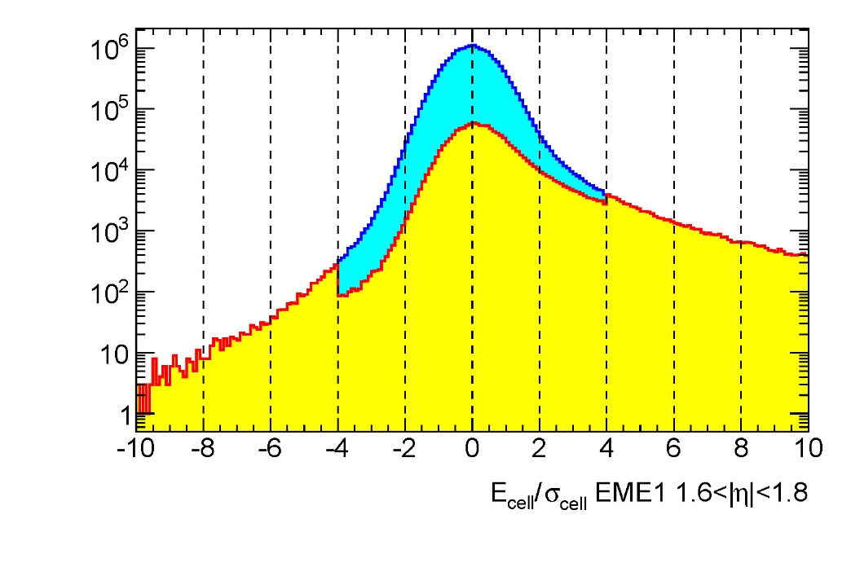
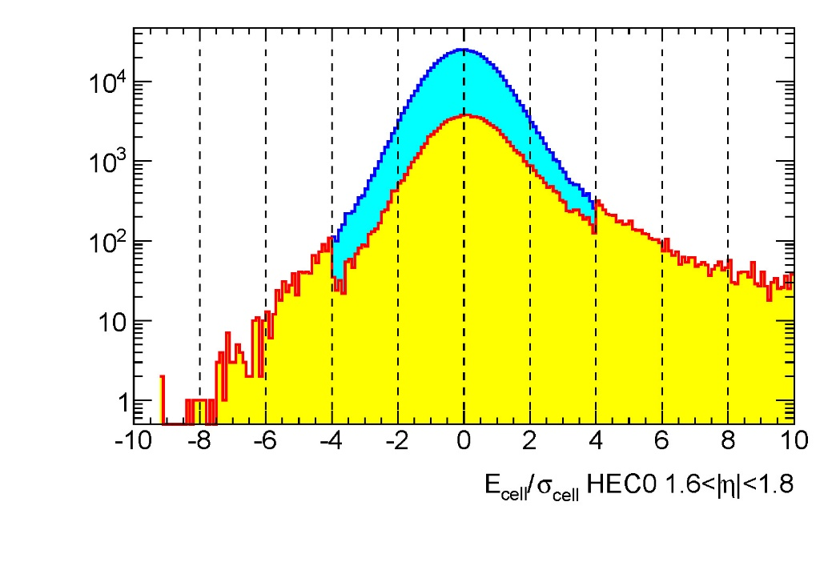
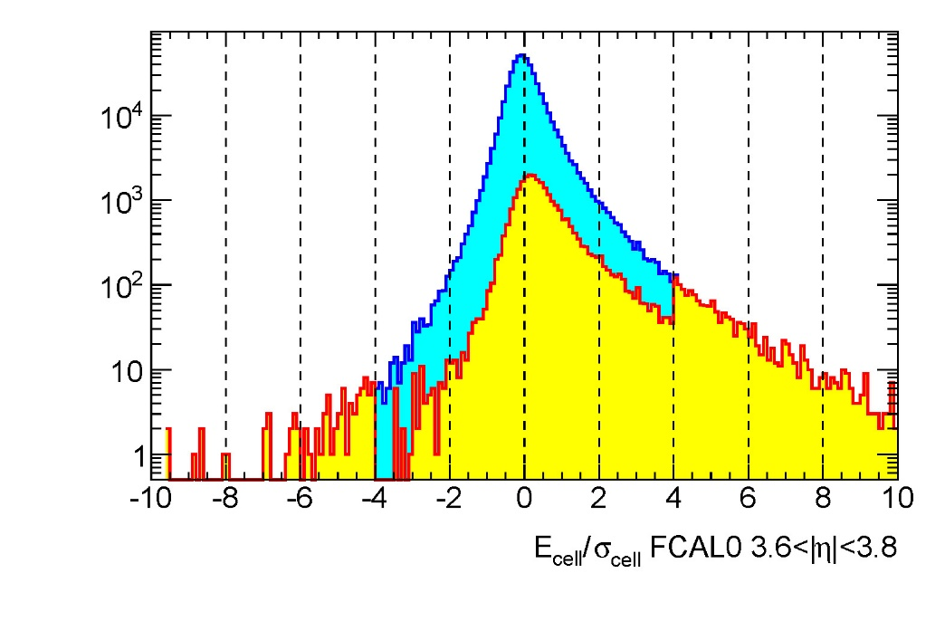
Cell Signal Significance In Clusters (1)

Slide 46
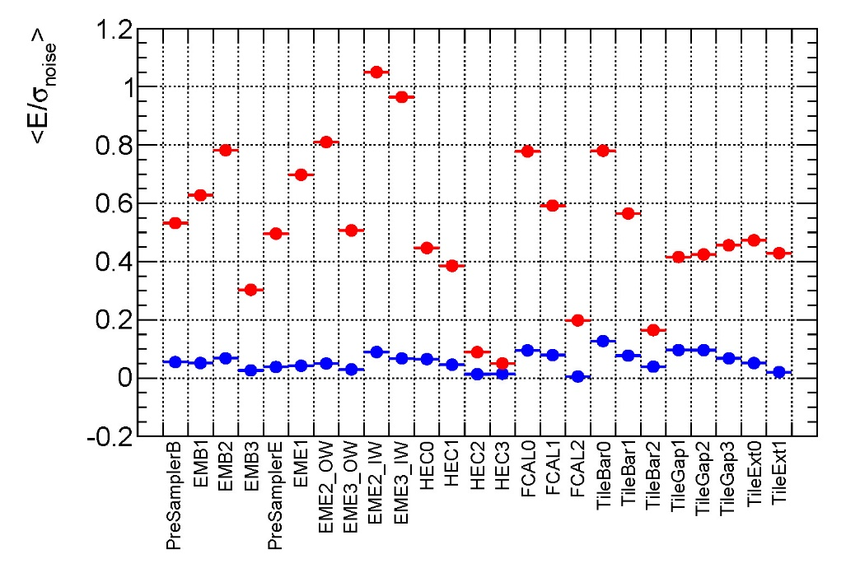
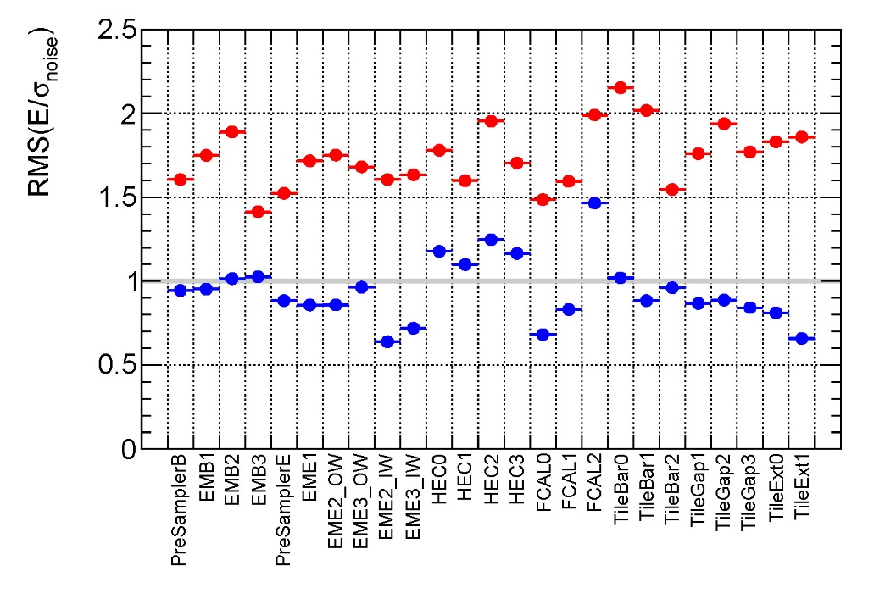
Cell Signal Significance In Clusters (2)
For this week:
Fraction of cells surviving clustering
5-20% for example data set, dependent on calorimeter region
Partial Gauss fits
Measure mop and sigma before (expected <0) and after (expected >0) clustering

Slide 47
Cluster Kinematics
Cluster signal
Sum of clustered cell energies
Possibly with geometrical weight introduced by cluster splitting
Cluster direction & location
Barycenter in (η,φ) from energy weighted cell directions
Negative signal cells contribute with absolute of their signal
Small effect on direction of final cluster from particles – negative signals are noise, i.e. small!
Consistent approach for direction calculation
Leaves true signal and noise clusters at the right direction
Same approach for geometrical signal center
“center of gravity”
Cluster four-momentum
Massless pseudo-particle approach similar to tower
Consistent with cluster idea of reconstructing showers rather than particles

Slide 48
Cluster Kinematics
Cluster signal
Sum of clustered cell energies
Possibly with geometrical weight introduced by cluster splitting
Cluster direction & location
Barycenter in (η,φ) from energy weighted cell directions
Negative signal cells contribute with absolute of their signal
Small effect on direction of final cluster from particles – negative signals are noise, i.e. small!
Consistent approach for direction calculation
Leaves true signal and noise clusters at the right direction
Same approach for geometrical signal center
“center of gravity”
Cluster four-momentum
Massless pseudo-particle approach similar to tower
Consistent with cluster idea of reconstructing showers rather than particles

Slide 49
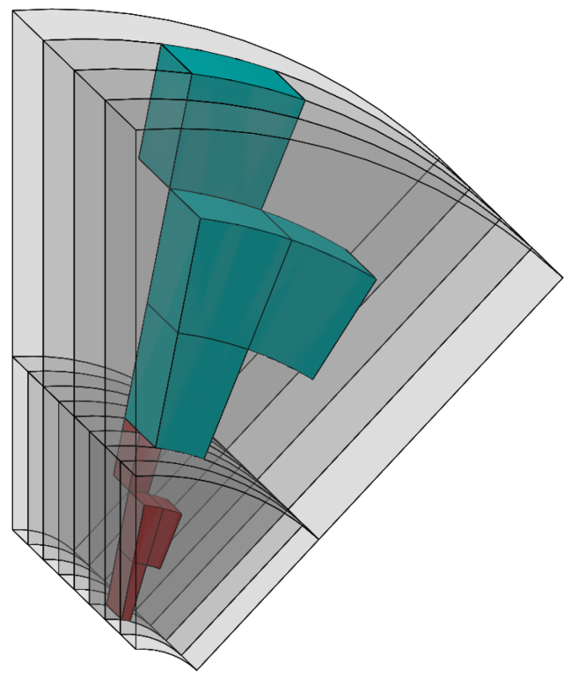
Cluster Features
Signal integration
Clusters sum cell signals without grid
3-dimensional signal objects
Can include partial and complete signals from several particles
Clusters preserve some detailed signal features
Associated information to be collected at cluster formation
E.g., energy sharing in electromagnetic and hadronic calorimeters
Longitudinal signal center of gravity
Shapes
Signal splitting
Topological clusters need splitting algorithm
Cannot follow individual showers perfectly in jet environments
Can cause problems with infrared safety
Few problems with seed and energy leakage
Can include energy from cells even outside of jet cone
(drawing by R. Walker, University of Arizona)
Topological cell cluster is a “blob” of energy dynamically located inside the calorimeter (even crossing sub-detector boundaries)

Slide 50
Local Hadronic Calibration

Slide 51
Cluster Calibration
General cluster features
Motivated by shower reconstruction
No bias in signal definition towards reconstruction of a certain, possibly very specific, physics signal object like a jet
Clusters have shapes and location information
Spatial cell energy distributions and their correlations drive longitudinal and lateral extensions
Density and energy sharing measures
Signal center of gravity and (directional) bary-center
Shapes are sensitive to shower nature
At least for a reasonable clustering algorithm
Local (cluster) calibration strategy
First reconstruct truly deposited energy at cluster location…
e/h, mostly
…then correct for other energy losses in the vicinity of signal cluster
Dead material energy losses and signal losses due to noise suppression
Calibration input
Reconstructed cluster shapes represent shower shapes
E.g., dense and compact clusters indicate electromagnetic shower activity anywhere in the calorimeter
Can be intrinsic to a hadronic shower!
Calibration functions can exploit the cluster shapes to apply the corrections for e/h ≠ 1 dynamically
Location of cluster together with shape
E.g., dense and compact clusters located in electromagnetic calorimeter indicate electron or photon as particle originating the signal
Cluster not (part of) hadronic shower signal!
Clusters can classified before calibration
Electron/photon clusters need different calibration than dense clusters from hadronic showers!
Cluster calibration extensions
Shapes, location and size also indicate possible energy losses around the cluster
Some correlations between energy losses in inactive material in front or inside of clusters
Cluster size and signal neighborhood sensitive to lost true signal in noise suppression algorithm
Out-of-cluster corrections

Slide 52
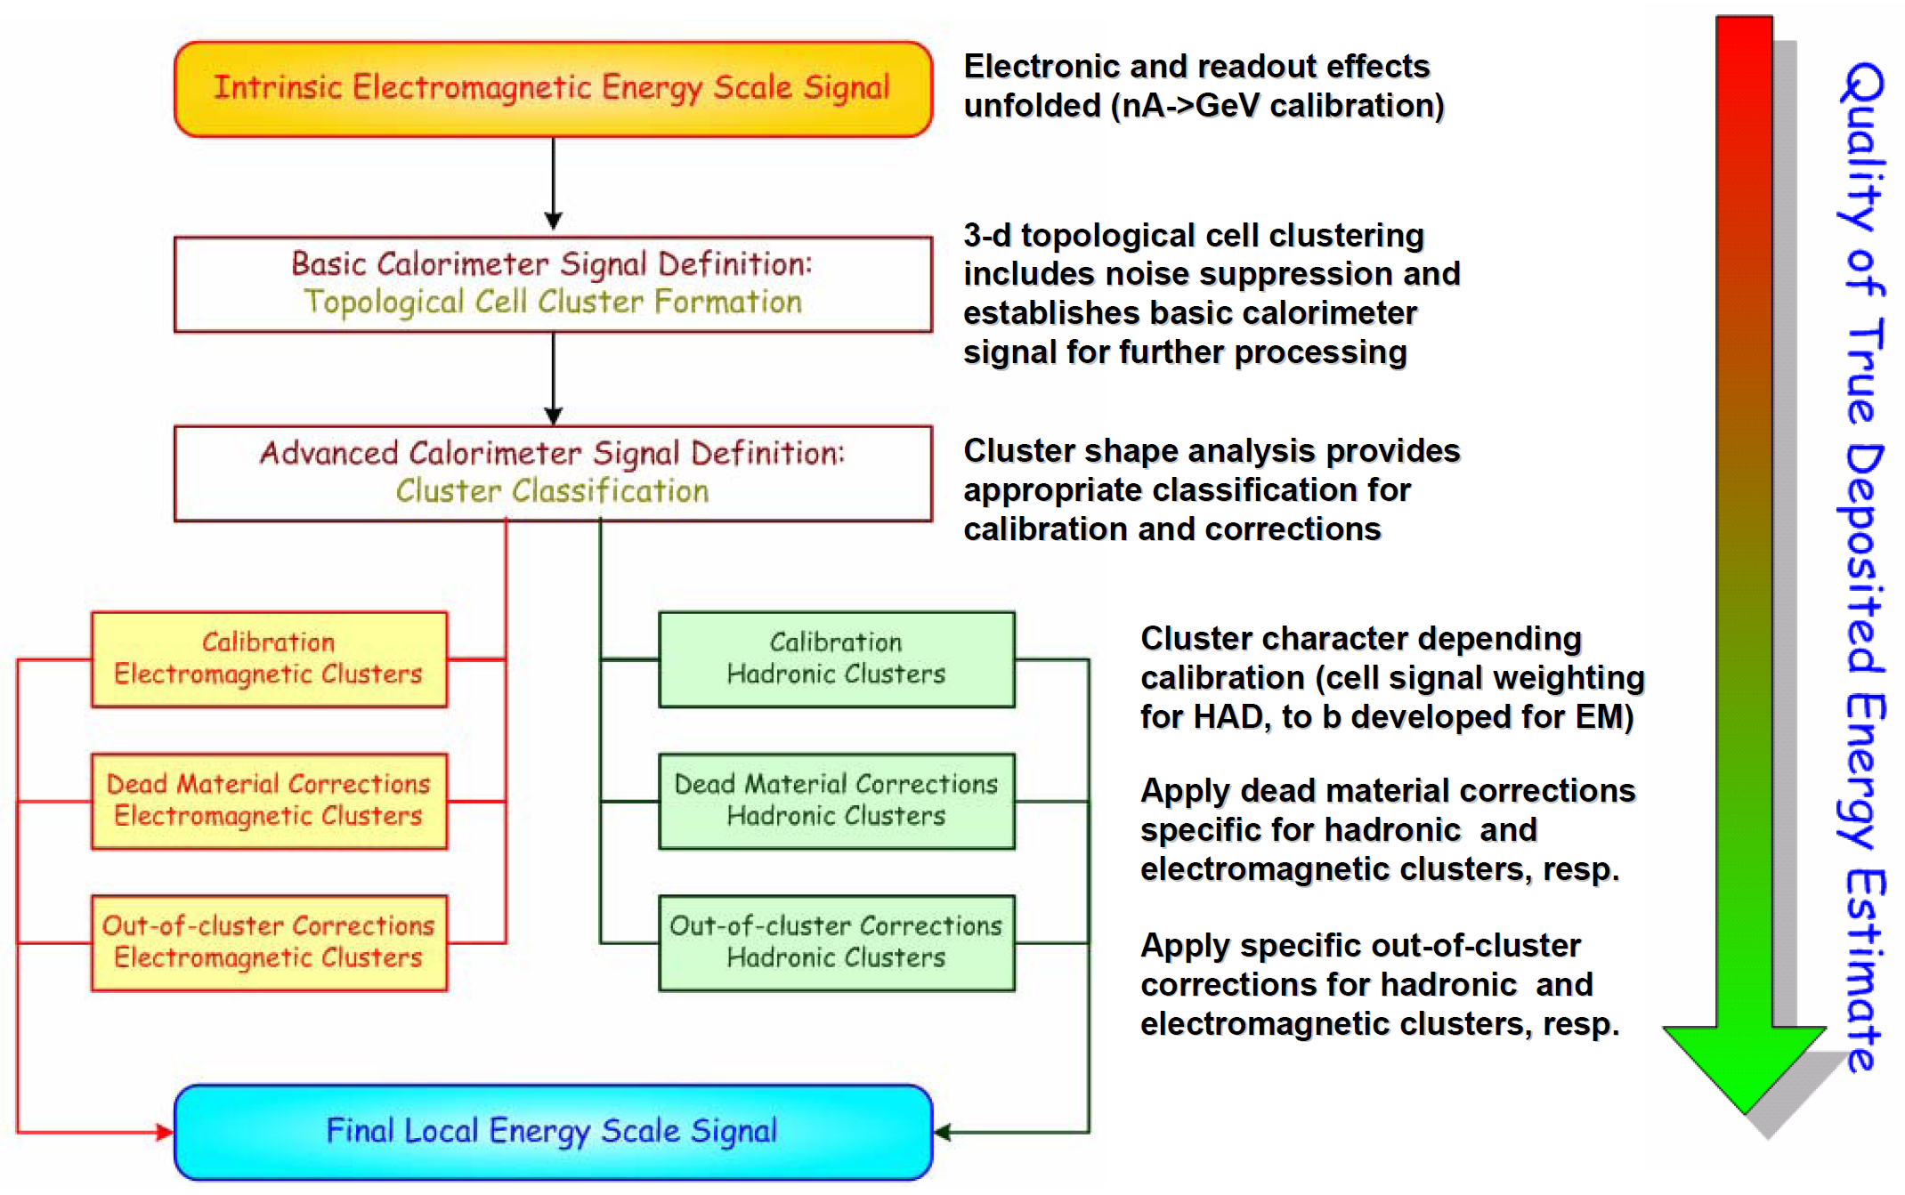
Cluster Calibration Sequence

Slide 53
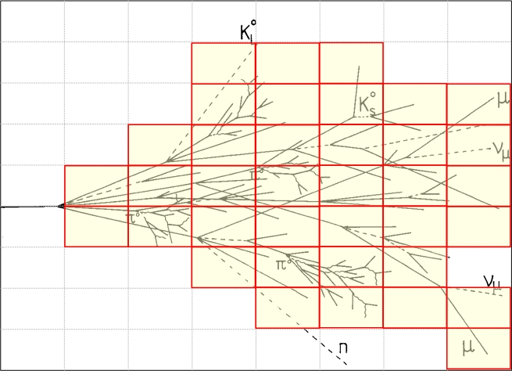
Hadronic Cluster Calibration
Calibration with cell signal weights
Idea is to compensate for lack of pion response in each cell
Pioneered in CDHS and applied in H1

Slide 54
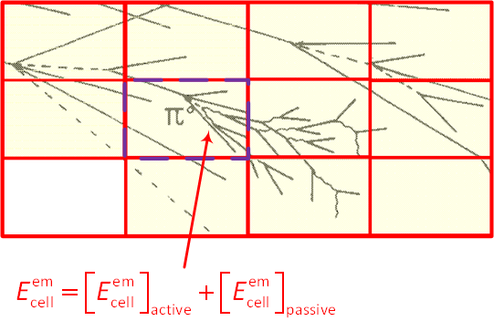
Hadronic Cluster Calibration
Calibration with cell signal weights
Idea is to compensate for lack of pion response in each cell
Pioneered in CDHS and applied in H1

Slide 55
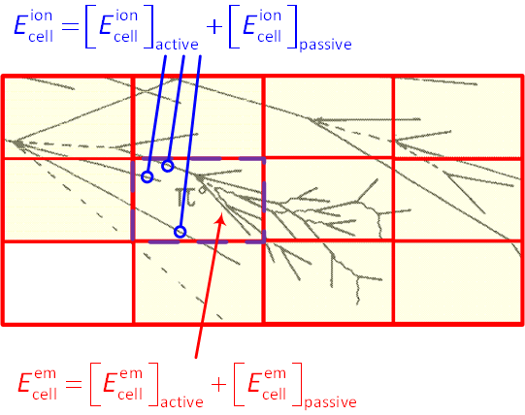
Hadronic Cluster Calibration
Calibration with cell signal weights
Idea is to compensate for lack of pion response in each cell
Pioneered in CDHS and applied in H1

Slide 56
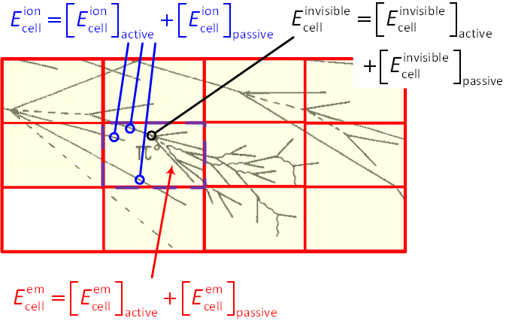
Hadronic Cluster Calibration
Calibration with cell signal weights
Idea is to compensate for lack of pion response in each cell
Pioneered in CDHS and applied in H1

Slide 57
Hadronic Cluster Calibration
Calibration with cell signal weights
Idea is to compensate for lack of pion response in each cell
Pioneered in CDHS and applied in H1
Uses deposited energies in cells
Deposit can be in active or passive medium of calorimeter!

Slide 58
Hadronic Cluster Calibration
Calibration with cell signal weights
Idea is to compensate for lack of pion response in each cell
Pioneered in CDHS and applied in H1
Uses deposited energies in cells
Deposit can be in active or passive medium of calorimeter!
Only signal contribution from energy deposited by electromagnetic sub-showers and through ionization by charged particles!

Slide 59
Hadronic Cluster Calibration
Calibration with cell signal weights
Idea is to compensate for lack of pion response in each cell
Pioneered in CDHS and applied in H1
Uses deposited energies in cells
Deposit can be in active or passive medium of calorimeter!
Energy deposited in cell not available in experiment
Use of detector simulations
Deposited energy and signal available
Use “unit cell” volume concept to collect invisible energies
Shower model dependent!
Use single pion testbeam data
Develop model for weights in cells
Fit parameters of model using cells testbeam
Minimize resolution with beam energy constraint
Statistical – does not necessarily produce the correct weights!

Slide 60
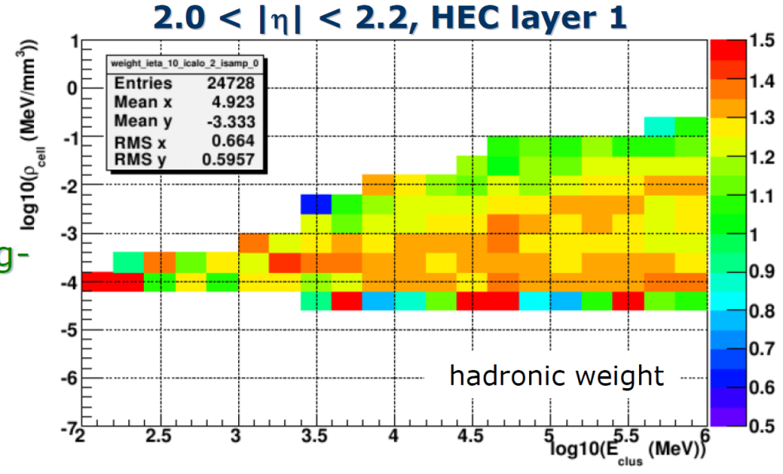

Cell Signal Weights
Basic idea
Use a dynamically self-adjusting calibration weight
High cell signal density → electromagnetic deposit
Low cell signal density → hadronic deposit
Principal weighting function characteristics
Depends on cell energy density
Depends on cell location
Accidental application to electron signals should yield correct energy as well
Extraction of weighting functions
Minimize resolution in (pion) testbeam data
Fitting function model
May not produce the correct weights – may even be unphysical!
Use simulation
Deterministic approach relates signal to deposited energy within cell volume – no fitting!
May depend on details of (hadronic) shower modeling
ATLAS cluster-based approach:
Use only cells in hadronic clusters
Cluster sets global energy scale as a reference for densities
Calculate E_{deposited,cell}/E_{0,cell} from single pion simulations in bins of cluster energy, cell energy density, cluster direction, and calorimeter sampling layer
Store [E_{deposited,cell}/E_{0,cell}]⁻¹ in look-up tables
Retrieve weights for any cell in any cluster from look-up table to reconstruct cell and cluster energies

Slide 61
Cell Signal Weights
Basic idea
Use a dynamically self-adjusting calibration weight
High cell signal density → electromagnetic deposit
Low cell signal density → hadronic deposit
Principal weighting function characteristics
Depends on cell energy density
Depends on cell location
Accidental application to electron signals should yield correct energy as well
Extraction of weighting functions
Minimize resolution in (pion) testbeam data
Fitting function model
May not produce the correct weights – may even be unphysical!
Use simulation
Deterministic approach relates signal to deposited energy within cell volume – no fitting!
May depend on details of (hadronic) shower modeling
ATLAS cluster-based approach:
Use only cells in hadronic clusters
Cluster sets global energy scale as a reference for densities
Calculate E_{deposited,cell}/E_{0,cell} from single pion simulations in bins of cluster energy, cell energy density, cluster direction, and calorimeter sampling layer
Store [E_{deposited,cell}/E_{0,cell}]⁻¹ in look-up tables
Retrieve weights for any cell in any cluster from look-up table to reconstruct cell and cluster energies

Slide 62
Cell Signal Weights
Basic idea
Use a dynamically self-adjusting calibration weight
High cell signal density → electromagnetic deposit
Low cell signal density → hadronic deposit
Principal weighting function characteristics
Depends on cell energy density
Depends on cell location
Accidental application to electron signals should yield correct energy as well
Extraction of weighting functions
Minimize resolution in (pion) testbeam data
Fitting function model
May not produce the correct weights – may even be unphysical!
Use simulation
Deterministic approach relates signal to deposited energy within cell volume – no fitting!
May depend on details of (hadronic) shower modeling
ATLAS cluster-based approach:
Use only cells in hadronic clusters
Cluster sets global energy scale as a reference for densities
Calculate E_{deposited,cell}/E_{0,cell} from single pion simulations in bins of cluster energy, cell energy density, cluster direction, and calorimeter sampling layer
Store [E_{deposited,cell}/E_{0,cell}]⁻¹ in look-up tables
Retrieve weights for any cell in any cluster from look-up table to reconstruct cell and cluster energies
Note that re-calculation of cluster kinematics (energy and directions) using calibrated (weighted) cell signals changes not only the cluster energy, but also the cluster direction (bary-center) and its geometrical center!

Slide 68
Cluster Dead Material Corrections
Dead material
Energy losses not directly measurable
Signal distribution in vicinity can help
Introduces need for signal corrections up to O(10%)
Exclusive use of signal features
Corrections depend on electromagnetic or hadronic energy deposit
Major contributions
Upstream materials
Material between LArG and Tile (central)
Cracks
dominant sources for signal losses
|η|≈1.4-1.5
|η|≈3.2
Clearly affects detection efficiency for particles and jets
Already in trigger!
Hard to recover jet reconstruction inefficiencies
Generate fake missing Et contribution
Topology dependence of missing Et reconstruction quality
Additive correction:
Relative energy loss in dead material
Relative energy loss in dead material

Slide 69
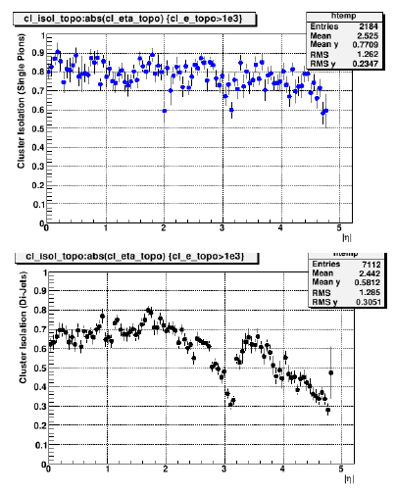
Out-of-cluster Corrections
Compensate loss of true signal
Limited efficiency of noise suppression scheme
Discard cells with small true energy not close to a primary or secondary seed
Accidental acceptance of a pure noise cell
Can be significant for isolated pions
10% at low energy
Correction derived from single pions
Compensates the isolated particle loss
But in jets neighboring clusters can pick up lost energy
Use isolation moment to measure effective “free surface” of each cluster
Scale single pion correction with this moment (0…1)
Additive correction:
single pions
QCD jets

Slide 70
TopoCluster Performance
In Data & MC

Slide 71
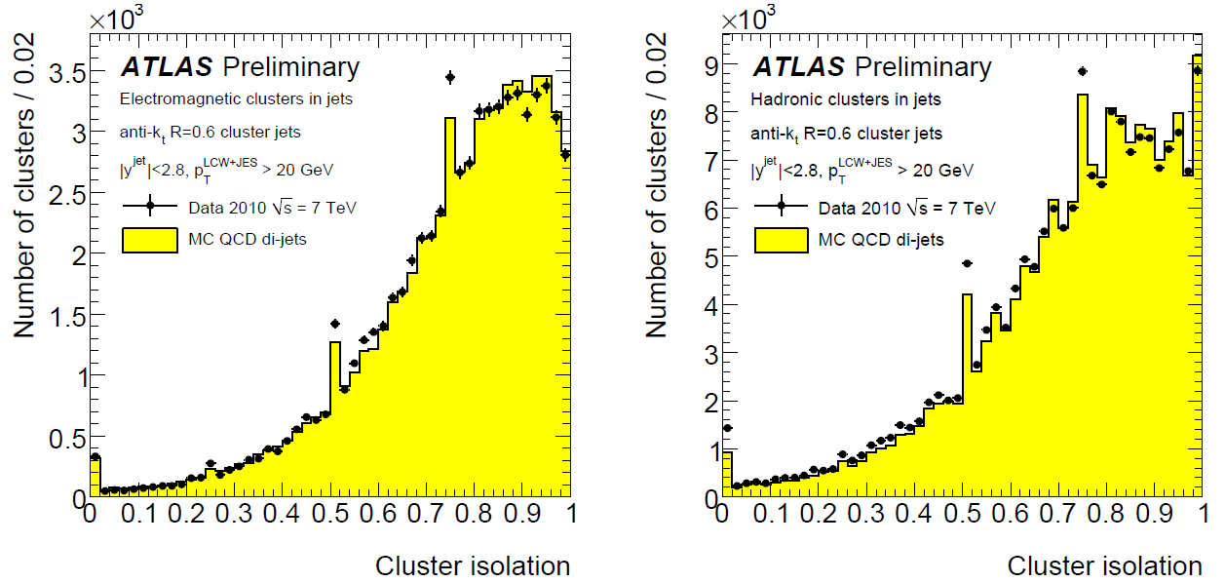
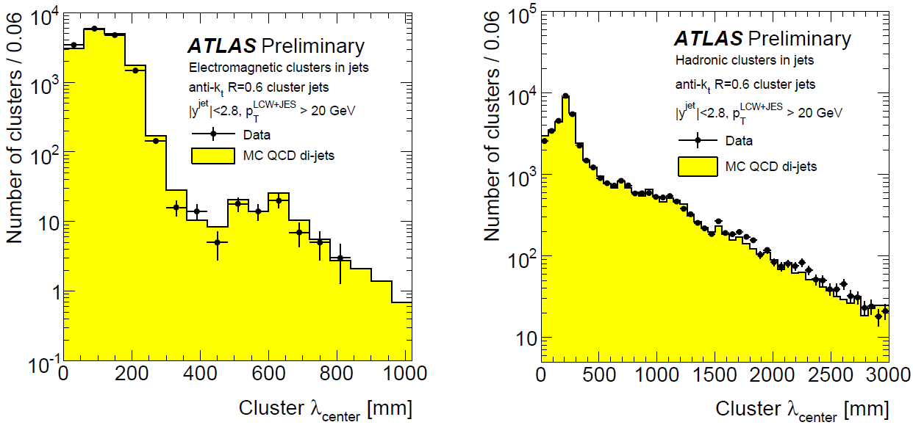
Validation of TopoCluster Moments
Local Hadronic Calibration (LCW) in cluster context
Attempt to reduce signal fluctuations dynamically
Explicit use of calorimeter signal features, e.g. cell energy density, spatial cell signal distribution
Applied at topological cell cluster level
Exploits cluster kinematics, shapes & location
cluster
isolation
(EM)
cluster
isolation
(HAD)
Complex cluster observables well described in MC
Distributions affected by shower structures, detector geometries, noise patterns, …
Simulation works well inside and outside of jets
cluster depth (EM)
cluster depth (HAD)
2010 Data/MC
(all plots on this slide from ATLAS-CONF-2010-053)

Slide 72
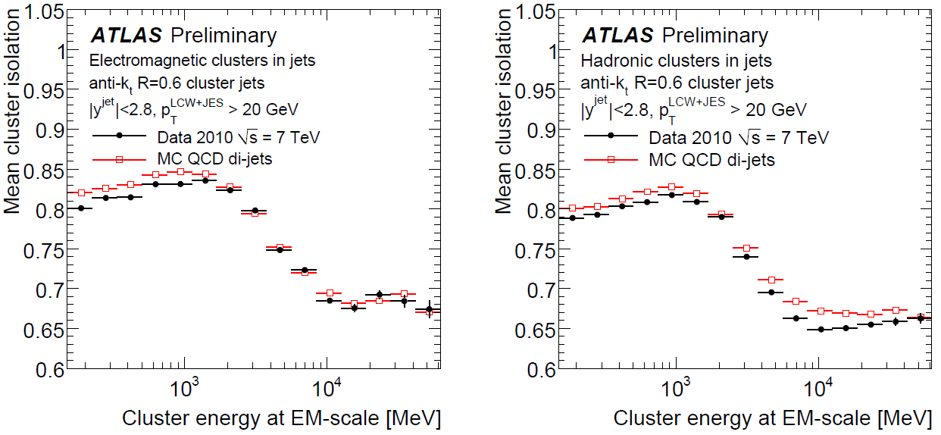
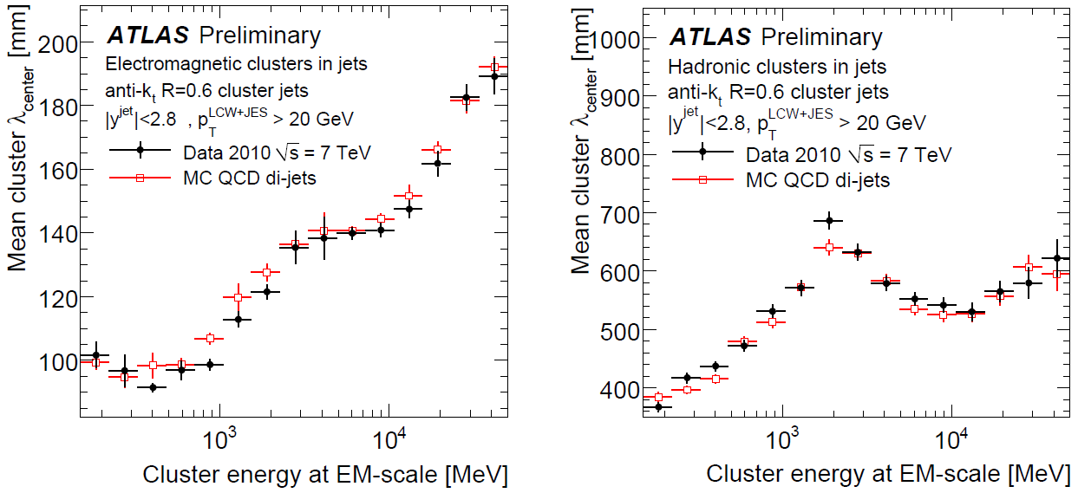
Cluster Variable Validation
Mean isolation for EM & HAD clusters
Average cluster depth
EM clusters
HAD clusters
2010 Data/MC
EM clusters
HAD clusters

Slide 73
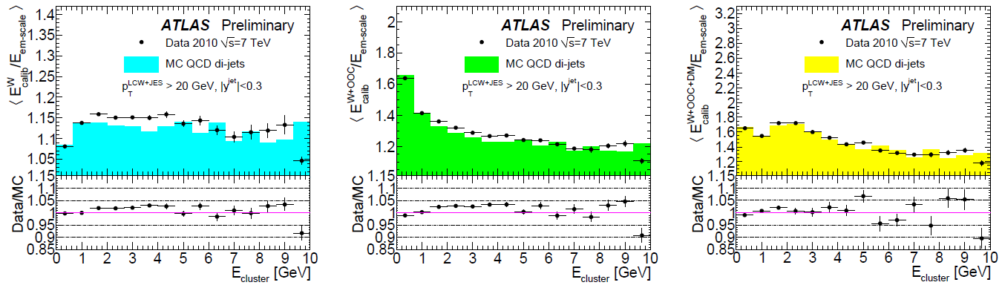
Jet Input Validation – Local Hadronic Energy Scale
LCW – cluster context hadronic calibration
Highly factorized scheme
Implements cluster classification specific calibration chains for electromagnetic and hadronic clusters
Corrections derived independently using detailed single particle simulations
All corrections derived from deposited energies at or around cluster location and their relation to the signal features
High demand on (detector) simulation quality
Each step validated with collision data
Calibration signal calibrations & corrections well reproduced even for clusters inside jets
Non-trivial confirmation of approach due to complex variable space and single particle source for parameters and functions
No significant quality variations as function of cluster location or transverse momentum
(all plots from ATLAS-CONF-2010-053)
+ out of cluster
+ dead material
hadronic response
2010 Data/MC

Slide 74
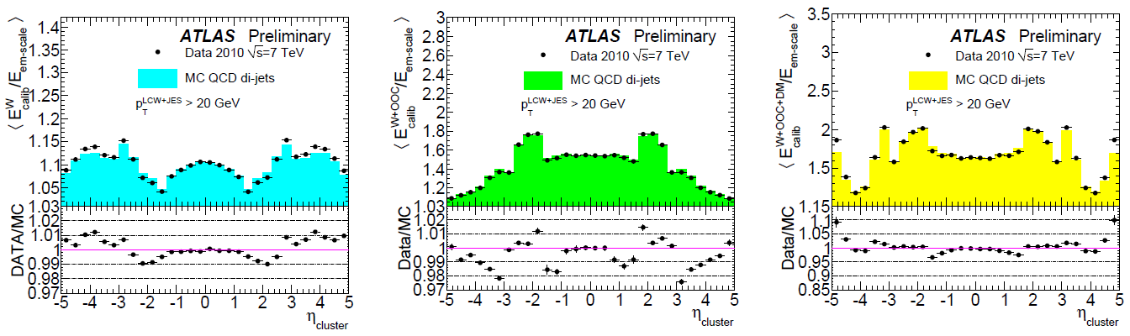
Jet Input Validation – Local Hadronic Energy Scale
LCW – cluster context hadronic calibration
Highly factorized scheme
Implements cluster classification specific calibration chains for electromagnetic and hadronic clusters
Corrections derived independently using detailed single particle simulations
All corrections derived from deposited energies at or around cluster location and their relation to the signal features
High demand on (detector) simulation quality
Each step validated with collision data
Calibration signal calibrations & corrections well reproduced even for clusters inside jets
Non-trivial confirmation of approach due to complex variable space and single particle source for parameters and functions
No significant quality variations as function of cluster location or transverse momentum
(all plots from ATLAS-CONF-2010-053)
hadronic response
+ out of cluster
+ dead material
hadronic response
+ out of cluster
+ dead material
2010 Data/MC

Slide 75
2011 MC

Slide 76
2011 MC

Slide 77
2011 MC

Slide 78
2011 MC

Slide 79
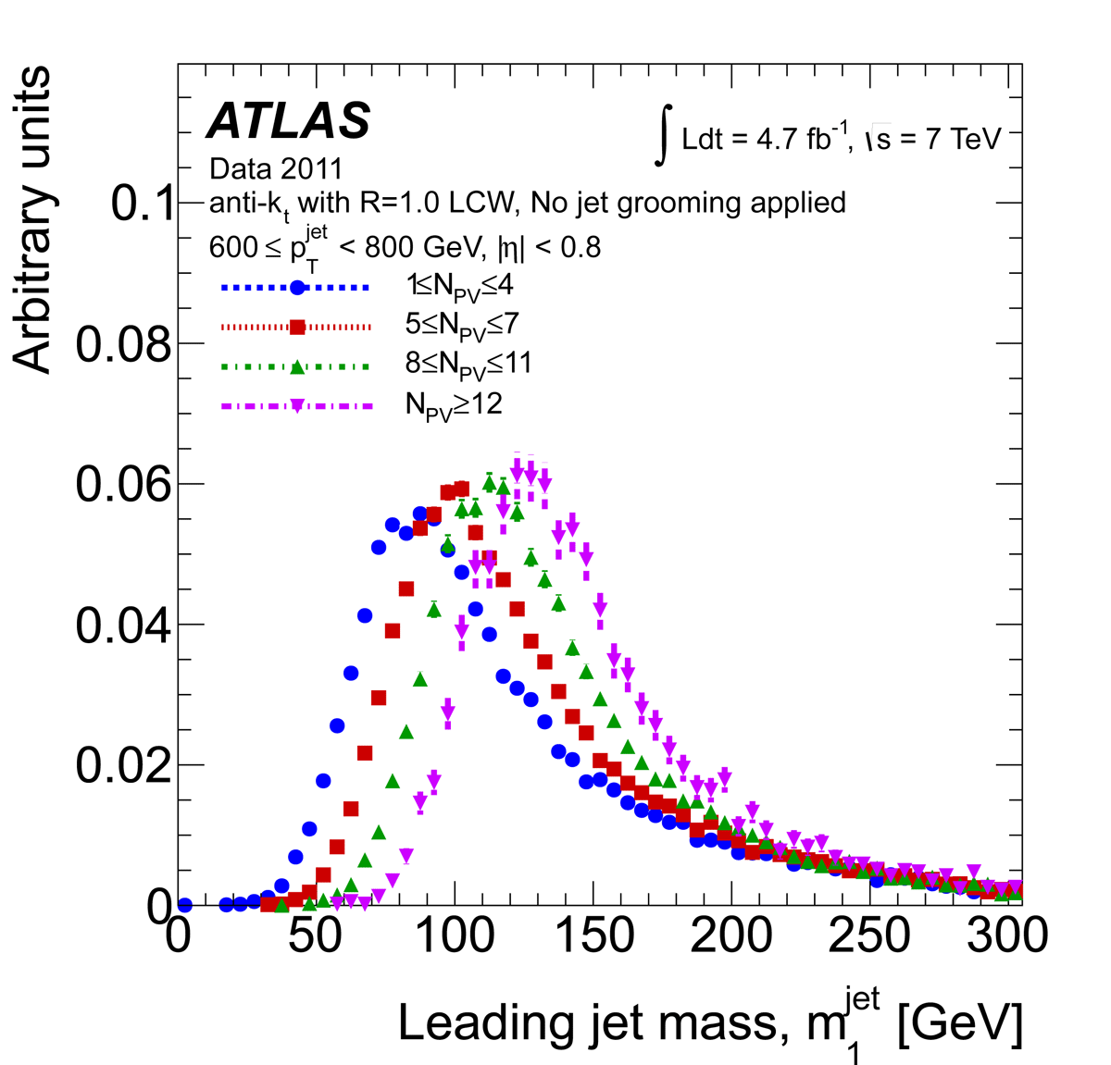
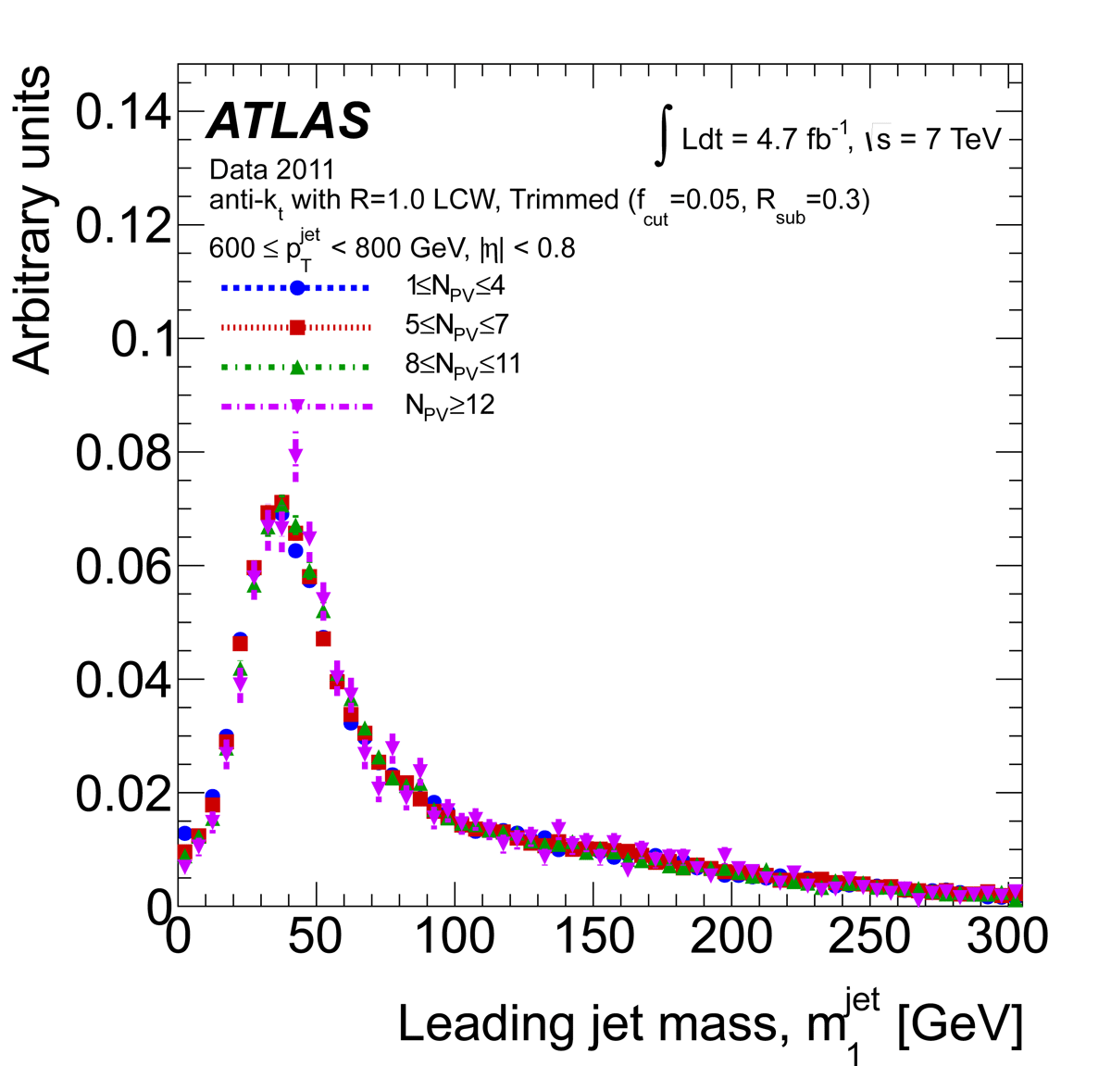
High Pile-up 2012
No dedicated study of 2011/2012 cluster properties in data (yet?)
Revival in the context of the TopoCluster paper – the hope!
We are trying to get this together Spring 2014…
See material attached to agenda for more information about clusters in pile-up…

Slide 80
Preparations for Higher Intensities and Energies
LHC 2015 & Beyond…

Slide 81
Future of TopoClusters (MHO!)
Formation
No particular need to change cluster formation
More important: update pilep-up fluctuations (RMS) – uses very old MC estimates, likely very wrong for endcap/forward
More plots to confirm this week!
Splitting scale is looked at
Plays ~0 role in cluster splitting in 2012 anyway, due to higher reconstruction thresholds – not a very critical parameter
Different (separate) treatment of (groups of) negative cells – not clear if this is useful? We can look at the HCW2013 contribution if interested…

Slide 82
Future of TopoClusters (MHO!)
Local calibration
Hadronic cell weights from single particle signals at chosen sigma
Important choice – works best if sigma matches fluctuations at the “same” μ!
Note that signals and truth reference do not include pile-up (in-time or out-of-time!
Task: check phase space for parameters used in calibrations and corrections in the presence of pile-up
Cluster shape/density/location modifications possibly shifting parameters and correlations outside of phase space covered by single pion MC…

Slide 83
Future of TopoClusters (MHO)
Pile-up suppression of clusters
Based on track-cluster matching
Potential to remove clusters matched to a non-primary vertex track…
Some concerns
Imbalance of neutral and charged response inside and outside e.g. jets
Stability of “classification” – easier to see for jets with finite catchment area, cluster catchment area not so clear…

Slide 84
Backup [1]
Principles of Calorimetry

Slide 85
Principles of Calorimetry
Detector needs for multi-purpose collider experiments
Tracking for charged particle momentum measurement
Calorimeters for charged and neutral particle energy measurement
Muon spectrometers (tracking) for muon momentum measurements
Underlying physics for calorimetry: particle interaction with matter
Electromagnetic cascades
Hadronic cascades
Muon energy loss
Calorimetric principles in particle detection
Conversion of deposited energy into an extractable signal in homogeneous and sampling calorimeters
Minimum ionizing particles and muons
General signal features of electromagnetic and hadronic showers
Calorimeter characteristics in sampling calorimeters
Sampling fraction
Signal linearity and relative resolution
Non-compensation
Signal extraction
Charge collection
Current measurement
Pulse shapes

Slide 86
Particle Interaction with Matter
Cascades or showers
Most particles entering matter start a shower of secondary particles
Exception: muons and neutrinos
The character of these cascades depends on the nature of the particle
Electrons, photons: cascades are formed by QED processes
Hadrons: cascades are dominantly formed by QCD processes
Extensions/size of these showers
Again depends on particle type
Electromagnetic showers typically small and compact
Hadronic showers much larger
Common feature: shower depths scales approximately as log(E)
Higher energies do not require much deeper detectors!
But very different longitudinal and radial scales - material and particle type dependent!
Shower development and age
Shower maximum
Depth at which average energy of shower particles is too small to continue production of secondaries – shower development starts to slow down/stop
Age of shower
Depth of shower
Shower width
Extend of shower perpendicular to direction of flight of incoming particle

Slide 87

Electromagnetic Showers
QED drives cascade development
High energetic electrons entering material emit photons in the electric field of the nuclei
Bremsstrahlung
High energetic photons produce e+e- pairs in the electric field of the nuclei
Pair production
Rossi’s shower model (1952!)
Simple model of interplay of electron energy loss and photon pair production
Uses critical energy as cutoff for shower development

Slide 88
Electromagnetic Showers
QED drives cascade development
High energetic electrons entering material emit photons in the electric field of the nuclei
Bremsstrahlung
High energetic photons produce e+e- pairs in the electric field of the nuclei
Pair production
Rossi’s shower model (1952!)
Simple model of interplay of electron energy loss and photon pair production
Uses critical energy as cutoff for shower development

Slide 89
Electromagnetic Showers
QED drives cascade development
High energetic electrons entering material emit photons in the electric field of the nuclei
Bremsstrahlung
High energetic photons produce e+e- pairs in the electric field of the nuclei
Pair production
Rossi’s shower model (1952!)
Simple model of interplay of electron energy loss and photon pair production
Uses critical energy as cutoff for shower development

Slide 90
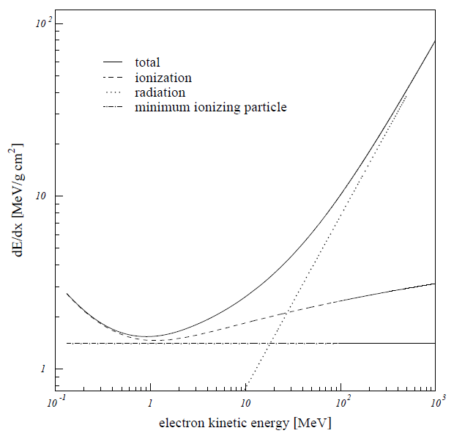
Electromagnetic Showers
QED drives cascade development
High energetic electrons entering material emit photons in the electric field of the nuclei
Bremsstrahlung
High energetic photons produce e+e- pairs in the electric field of the nuclei
Pair production
Rossi’s shower model (1952!)
Simple model of interplay of electron energy loss and photon pair production
Uses critical energy as cutoff for shower development

Slide 91
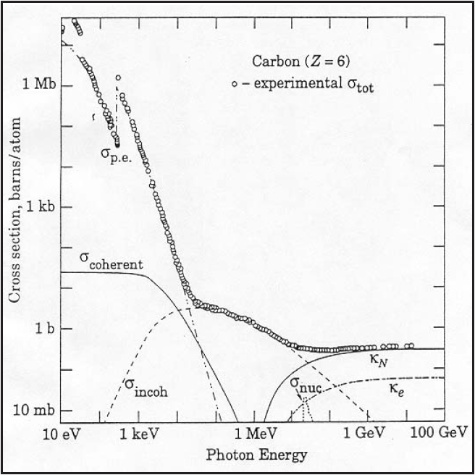
Electromagnetic Showers
QED drives cascade development
High energetic electrons entering material emit photons in the electric field of the nuclei
Bremsstrahlung
High energetic photons produce e+e- pairs in the electric field of the nuclei
Pair production
Rossi’s shower model (1952!)
Simple model of interplay of electron energy loss and photon pair production
Uses critical energy as cutoff for shower development

Slide 92

Hadronic Showers
QCD drives fast shower development
Hadron interacts with nucleon in nuclei
Like a fixed target collision
Develops intra-nuclear cascade (fast)
Hadron production
Secondary hadrons escape nucleus
Neutral pions decay immediately into 2 photons → electromagnetic cascade
Other hadrons can hit other nucleons → inter-nuclear cascade
Slow de-excitation of nuclei
Remaining nucleus in excited state
Evaporates energy to reach stable (ground) state
Fission and spallation possible
Binding energy and low energetic photons
Large process fluctuations
~200 different interactions
Probability for any one of those < 1%!

Slide 93
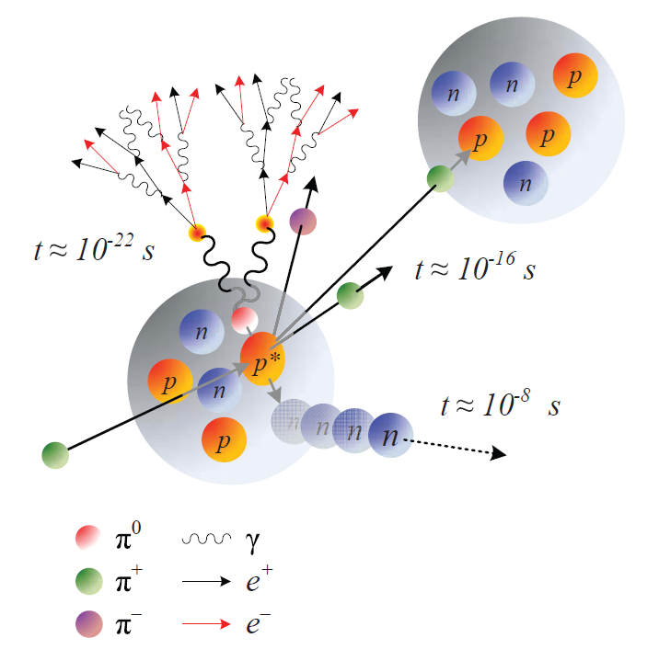
Hadronic Showers
QCD drives fast shower development
Hadron interacts with nucleon in nuclei
Like a fixed target collision
Develops intra-nuclear cascade (fast)
Hadron production
Secondary hadrons escape nucleus
Neutral pions decay immediately into 2 photons → electromagnetic cascade
Other hadrons can hit other nucleons → inter-nuclear cascade
Slow de-excitation of nuclei
Remaining nucleus in excited state
Evaporates energy to reach stable (ground) state
Fission and spallation possible
Binding energy and low energetic photons
Large process fluctuations
~200 different interactions
Probability for any one of those < 1%!

Slide 94

Hadronic Showers
QCD drives fast shower development
Hadron interacts with nucleon in nuclei
Like a fixed target collision
Develops intra-nuclear cascade (fast)
Hadron production
Secondary hadrons escape nucleus
Neutral pions decay immediately into 2 photons → electromagnetic cascade
Other hadrons can hit other nucleons → internuclear cascade
Slow de-excitation of nuclei
Remaining nucleus in excited state
Evaporates energy to reach stable (ground) state
Fission and spallation possible
Binding energy and low energetic photons
Large process fluctuations
~200 different interactions
Probability for any one of those < 1%!
Grupen,
Particle Detectors
Cambridge University Press (1996)

Slide 95

Hadronic Showers
GEANT4 Simulation: 10 GeV π⁺ in copper

Slide 96
Calorimeter Basics (1)
Full absorption detector
Idea is to convert incoming particle energy into detectable signals
Light or electric current
Should work for charged and neutral particles
Exploits the fact that particles entering matter deposit their energy in particle cascades
Electrons/photons in electromagnetic showers
Charged pions, protons, neutrons in hadronic showers
Muons do not shower at all in general
Principal design challenges
Need dense matter to absorb particles within a small detector volume
Lead for electrons and photons, copper or iron for hadrons
Need “light” material to collect signals with least losses
Scintillator plastic, nobel gases and liquids
Solution I: combination of both features
Crystal calorimetry, BGO
Solution II: sampling calorimetry

Slide 97
Calorimeter Basics (2)
Sampling calorimeters
Use dense material for absorption power…
No direct signal
…in combination with highly efficient active material
Generates signal
Consequence: only a certain fraction of the incoming energy is directly converted into a signal
Typically 1-10%
Signal is therefore subjected to sampling statistics
The same energy loss by a given particle type may generate different signals
Limit of precision in measurements
Need to understand particle response
Electromagnetic and hadronic showers

Slide 98

Electromagnetic Cascades in Calorimeters
Electromagnetic showers
Particle cascade generated by electrons/positrons and photons in matter
Developed by bremsstrahlung & pair-production
Compact signal expected
Regular shower shapes
Small shower-to-shower fluctuations
Strong correlation between longitudinal and lateral shower spread
RD3 note 41, 28 Jan 1993
C. Amsler et al. (Particle Data Group), Physics Letters B667, 1 (2008) and 2009 partial update for the 2010 edition

Slide 99

Electromagnetic Cascades in Calorimeters
Electromagnetic showers
Particle cascade generated by electrons/positrons and photons in matter
Developed by bremsstrahlung & pair-production
Compact signal expected
Regular shower shapes
Small shower-to-shower fluctuations
Strong correlation between longitudinal and lateral shower spread
RD3 note 41, 28 Jan 1993
C. Amsler et al. (Particle Data Group), Physics Letters B667, 1 (2008) and 2009 partial update for the 2010 edition

Slide 100


Electromagnetic Cascades in Calorimeters
Electromagnetic showers
Particle cascade generated by electrons/positrons and photons in matter
Developed by bremsstrahlung & pair-production
Compact signal expected
Regular shower shapes
Small shower-to-shower fluctuations
Strong correlation between longitudinal and lateral shower spread
P. Loch (Diss.), University of Hamburg 1992
RD3 note 41, 28 Jan 1993

Slide 101

Electromagnetic Cascades in Calorimeters
Electromagnetic showers
Particle cascade generated by electrons/positrons and photons in matter
Developed by bremsstrahlung & pair-production
Compact signal expected
Regular shower shapes
Small shower-to-shower fluctuations
Strong correlation between longitudinal and lateral shower spread
P. Loch (Diss.), University of Hamburg 1992
RD3 note 41, 28 Jan 1993
G.A. Akopdzhanov et al. (Particle Data Group), Physics Letters B667, 1 (2008) and 2009 partial update for the 2010 edition

Slide 102

Hadronic Cascades in Calorimeters
Hadronic signals
Much larger showers
Need deeper development
Wider shower spread
Large energy losses without signal generation in hadronic shower component
Binding energy losses
Escaping energy/slow particles (neutrinos/neutrons)
Signal depends on size of electromagnetic component
Energy invested in neutral pions lost for further hadronic shower development
Fluctuating significantly shower-by-shower
Weakly depending on incoming hadron energy
Consequence: non-compensation
Hadrons generate less signal than electrons depositing the same energy
30 GeV electrons
30 GeV pions
5 GeV electrons
P. Loch (Diss.), University of Hamburg 1992

Slide 103

Hadronic Cascades in Calorimeters
Hadronic signals
Much larger showers
Need deeper development
Wider shower spread
Large energy losses without signal generation in hadronic shower component
Binding energy losses
Escaping energy/slow particles (neutrinos/neutrons)
Signal depends on size of electromagnetic component
Energy invested in neutral pions lost for further hadronic shower development
Fluctuating significantly shower-by-shower
Weakly depending on incoming hadron energy
Consequence: non-compensation
Hadrons generate less signal than electrons depositing the same energy
5 GeV π ̶
30 GeV π ̶
80 GeV π ̶
P. Loch (Diss.), University of Hamburg 1992

Slide 104


Shower Features Summary
Electromagnetic
Compact
Growths in depth ~log(E)
Longitudinal extension scale is radiation length X₀
Distance in matter in which ~50% of electron energy is radiated off
Photons 9/7 X₀
Strong correlation between lateral and longitudinal shower development
Small shower-to-shower fluctuations
Very regular development
Can be simulated with high precision
1% or better, depending on features
Hadronic
Scattered, significantly bigger
Growths in depth ~log(E)
Longitudinal extension scale is interaction length λ >> X₀
Average distance between two inelastic interactions in matter
Varies significantly for pions, protons, neutrons
Weak correlation between longitudinal and lateral shower development
Large shower-to-shower fluctuations
Very irregular development
Can be simulated with reasonable precision
~2-5% depending on feature

Slide 105
Backup [2]
Calorimeter Signal
Formation

Slide 106

Signal Formation: Electromagnetic Signals
Signal features in sampling calorimeters
Collected from ionizations in active material
Not all energy deposit converted to signal
Proportional to incoming electron/photon
C.f. Rossi’s shower model, Approximation B
Only charged tracks contribute to signal
Only pair-production for photons
Energy loss is constant
Signal proportional to integrated shower particle path
Stochastical fluctuations
Sampling character
Sampling fraction
Describes average fraction of deposited energy generating the signal

Slide 107
Signal Formation: Sampling Fraction
Characterizes sampling calorimeters
Ratio of energy deposited in active material and total energy deposit
Assumes constant energy loss per unit depth in material
Ionization only
Can be adjusted when designing the calorimeter
Material choices
Readout geometry
Multiple scattering
Changes sampling fraction
Effective extension of particle path in matter
Different for absorber and active material
Showering
Cannot be included in sampling fraction analytically
Need measurements and/or simulations

Slide 108

Signal Formation: Sampling Fraction
Characterizes sampling calorimeters
Ratio of energy deposited in active material and total energy deposit
Assumes constant energy loss per unit depth in material
Ionization only
Can be adjusted when designing the calorimeter
Material choices
Readout geometry
Multiple scattering
Changes sampling fraction
Effective extension of particle path in matter
Different for absorber and active material
Showering
Cannot be included in sampling fraction analytically
Need measurements and/or simulations
C. Amsler et al. (Particle Data Group), Physics Letters B667, 1 (2008) and 2009 partial update for the 2010 edition

Slide 109

Signal Formation: Sampling Fraction
Characterizes sampling calorimeters
Ratio of energy deposited in active material and total energy deposit
Assumes constant energy loss per unit depth in material
Ionization only
Can be adjusted when designing the calorimeter
Material choices
Readout geometry
Multiple scattering
Changes sampling fraction
Effective extension of particle path in matter
Different for absorber and active material
Showering
Cannot be included in sampling fraction analytically
Need measurements and/or simulations
Showering changes the electron sampling fraction mostly due to the strong dependence of photon capture (photo-effect) on the material (cross-section ~Z⁵) leading to a non-proportional absorption of energy carried by soft photons deeper in the shower!
Electrons
80 GeV
5 GeV
P. Loch (Diss.), University of Hamburg 1992
30 GeV

Slide 110


Signal Extraction
Example: charge collection in noble liquids
Charged particles ionizing active medium when traversing it
Fast passage compared to electron drift velocity in medium
Electrons from these ionizations are collected in external electric field
Similar to collection of 1-dim “line of charges” with constant charge density
Resulting (electron) current is base of signal
Positive ions much slower
Can collect charges or measure current
Characteristic features
Collected charge and current are proportional to energy deposited in active medium
Drift time for electrons in active medium
Determines charge collection time
Can be adjusted to optimize calorimeter performance

Slide 111
Backup [3]
Signals in the ATLAS LAr Calorimeters

Slide 112
ATLAS Calorimeter Signal Extraction
What is response?
Reconstructed calorimeter signal
Based on the direct measurement – the raw signal
May include noise suppression
Has the concept of signal (or energy) scale
Mostly understood as the basic signal before final calibrations
Does not explicitly include particle or jet hypothesis
Uses only calorimeter signal amplitudes, spatial distributions, etc.

Slide 113
Calorimeter Signal in ATLAS
Slow signal collection in liquid argon calorimeters
~450 ns @ 1 kV/mm drift time versus 40 MHz/25 ns bunch crossing time
Measure only I₀ = I(t₀) (integrate <25 ns)
Applying a fast bi-polar signal shaping
Shaping time ~15 ns
With well known shape
Shaped pulse integral = 0
Net average signal contribution from pile-up = 0
Need to measure the pulse shape (time sampled readout)
Total integration ~25 bunch crossings
23 before signal, 1 signal, 1 after signal
reading out (digitize) 5 samples sufficient!

Slide 114

Pile-up Suppression in ATLAS
General strategies
Build calorimeter with relatively fast signal collection
E.g., ATLAS tile, CMS crystal & tile
Only sensitive to small time window around triggered signal
Convert slow pulse to net-zero area bi-polar pulse
E.g, ATLAS liquid argon
Measures initial current rather than total charge
Signals from pile-up history suppress in-time pile-up contribution due to pulse shape
Exercise
Pile-up suppression in various LHC bunch crossing timing
following bunch crossings
past bunch crossings

Slide 115
Pile-up Suppression in ATLAS
following bunch crossings
past bunch crossings

Slide 116

Pile-up Suppression in ATLAS
following bunch crossings
past bunch crossings

Slide 117

Pile-up Suppression in ATLAS
following bunch crossings
past bunch crossings

Slide 118

Pile-up Suppression in ATLAS
following bunch crossings
past bunch crossings

Slide 119

Pile-up Suppression in ATLAS
following bunch crossings
past bunch crossings

Slide 120

Pile-up Suppression in ATLAS
increasing pile-up effect on signal
decreasing pile-up history

Slide 121
Pile-up Suppression in ATLAS
Online pile-up suppression
Attempt to compensate signal contributions from in-time pile-up by suppression from physics signals in the pile-up history
Can only suppress average in-time pile-up contribution in any given calorimeter cell
Residual in-time pile-up effects still to be addressed offline
Non-gaussian fluctuations in signal from minimum bias events in a given cell – tails due to physics fluctuations and coherent noise effects
Distortion of pile-up history
LHC bunch structure and super-structure makes pile-up history dependent on phase with respect to bunch gaps
Works better in high lumi/high bunch crossing scenario
Better cancellation with more stable average energy & finer integration of pulse shape

Slide 122

Pile-up Suppression in ATLAS
Online pile-up suppression
Attempt to compensate signal contributions from in-time pile-up by suppression from physics signals in the pile-up history
Can only suppress average in-time pile-up contribution in any given calorimeter cell
Residual in-time pile-up effects still to be addressed offline
Non-gaussian fluctuations in signal from minimum bias events in a given cell – tails due to physics fluctuations and coherent noise effects
Distortion of pile-up history
LHC bunch structure and super-structure makes pile-up history dependent on phase with respect to bunch gaps
Works better in high lumi/high bunch crossing scenario
Better cancellation with more stable average energy & finer integration of pulse shape
in-time + next
over-compensation due to lack of next bunch-crossing w/collisions

Slide 123

Pile-up Suppression in ATLAS
Online pile-up suppression
Attempt to compensate signal contributions from in-time pile-up by suppression from physics signals in the pile-up history
Can only suppress average in-time pile-up contribution in any given calorimeter cell
Residual in-time pile-up effects still to be addressed offline
Non-gaussian fluctuations in signal from minimum bias events in a given cell – tails due to physics fluctuations and coherent noise effects
Distortion of pile-up history
LHC bunch structure and super-structure makes pile-up history dependent on phase with respect to bunch gaps
Works better in high lumi/high bunch crossing scenario
Better cancellation with more stable average energy & finer integration of pulse shape
in-time only

Slide 124

Pile-up Suppression in ATLAS
Online pile-up suppression
Attempt to compensate signal contributions from in-time pile-up by suppression from physics signals in the pile-up history
Can only suppress average in-time pile-up contribution in any given calorimeter cell
Residual in-time pile-up effects still to be addressed offline
Non-gaussian fluctuations in signal from minimum bias events in a given cell – tails due to physics fluctuations and coherent noise effects
Distortion of pile-up history
LHC bunch structure and super-structure makes pile-up history dependent on phase with respect to bunch gaps
Works better in high lumi/high bunch crossing scenario
Better cancellation with more stable average energy & finer integration of pulse shape
in-time only

Slide 125

Pile-up Suppression in ATLAS
Online pile-up suppression
Attempt to compensate signal contributions from in-time pile-up by suppression from physics signals in the pile-up history
Can only suppress average in-time pile-up contribution in any given calorimeter cell
Residual in-time pile-up effects still to be addressed offline
Non-gaussian fluctuations in signal from minimum bias events in a given cell – tails due to physics fluctuations and coherent noise effects
Distortion of pile-up history
LHC bunch structure and super-structure makes pile-up history dependent on phase with respect to bunch gaps
Works better in high lumi/high bunch crossing scenario
Better cancellation with more stable average energy & finer integration of pulse shape
in-time only

Slide 126

Effects of Pile-up in ATLAS
More observations for 2011 ATLAS data
Effective pile-up suppression
Depends on distance from front of bunch train
Depends on distance to back of bunch train
Depends on gaps between bunch trains
9, 20, 25, >> 25 bX…
Digital filtering effect
Fitting fixed physics pulse shape puts signal (“energy”) in time slots without bunch crossing
Especially observed in last bunch crossing at end of train – expected over-compensation by history from previous bunch crossings only for τ_{bx} = 25 ns, but also observed for τ_{bx} = 50 ns!
Understanding pile-up in ATLAS
Not as simple as adding particles from additional in-time collisions
ATLAS sees a reduced signal from those
Overall signal contribution is complex
Depends not only on number of additional collisions
Need to estimate average pile-up “around” triggered event ($<µ>$)

Slide 127
Calorimeter Response

Slide 128
Calorimeter Response
What does signal or energy scale mean?
Indicates a certain level of signal reconstruction
Standard reconstruction often stops with a basic signal scale
Electromagnetic energy scale is a good reference
Uses direct signal proportionality to electron/photon energy
Accessible in test beam experiments
Can be validated with isolated particles in collision environment
Provides good platform for data and simulation comparisons
Does not necessarily convert the electron signal to the true photon/electron energy!
Hadronic signals can also be calculated on this scale
Good platform for comparisons to simulations
But does not return a good estimate for the deposited energy in non-compensating calorimeters – see later discussion!
Is not a fundamental concept of physics!
Is a calorimeter feature
Definition varies from experiment to experiment

Slide 129
Hadronic Response (1)
D.Groom et al., NIM A338, 336-347 (1994)

Slide 130
Hadronic Response (2)
Observable
provides experimental access to characteristic calorimeter variables in pion test beams by fitting h/e, E_{base} and m from the energy dependence of the pion signal on electromagnetic energy scale:
Note that e/h is often constant, for example: in both H1 and ATLAS about 50% of the energy in the hadronic branch generates a signal, with this fraction being independent of the energy itself

Slide 131

Jet Response
Complex mixture of hadrons and photons
Not a single particle response
Carries initial electromagnetic energy
Mainly photons
Very simple response model
Assume the hadronic jet content is represented by 1 particle only
Not realistic, but helpful to understand basic response features
More evolved model
Use fragmentation function in jet response
This has some practical considerations
E.g. jet calibration in CDF
Gets non-compensation effect
Does not address acceptance effect due to shower overlaps

Slide 132
Jet Response
Complex mixture of hadrons and photons
Not a single particle response
Carries initial electromagnetic energy
Mainly photons
Very simple response model
Assume the hadronic jet content is represented by 1 particle only
Not realistic, but helpful to understand basic response features
More evolved model
Use fragmentation function in jet response
This has some practical considerations
E.g. jet calibration in CDF
Gets non-compensation effect
Does not address acceptance effect due to shower overlaps

Slide 133
Jet Response
Complex mixture of hadrons and photons
Not a single particle response
Carries initial electromagnetic energy
Mainly photons
Very simple response model
Assume the hadronic jet content is represented by 1 particle only
Not realistic, but helpful to understand basic response features
More evolved model
Use fragmentation function in jet response
This has some practical considerations
E.g. jet calibration in CDF
Gets non-compensation effect
Does not address acceptance effect due to shower overlaps
Response Ratio
Energy (GeV)

Slide 134
Jet Response
Complex mixture of hadrons and photons
Not a single particle response
Carries initial electromagnetic energy
Mainly photons
Very simple response model
Assume the hadronic jet content is represented by 1 particle only
Not realistic, but helpful to understand basic response features
More evolved model
Use fragmentation function in jet response
This has some practical considerations
E.g. jet calibration in CDF
Gets non-compensation effect
Does not address acceptance effect due to shower overlaps

Slide 135

ATLAS Detector

Slide 136

ATLAS – Multipurpose LHC Detector
Total weight : 7000 t
Overall length: 46 m
Overall diameter: 23 m
Magnetic field: 2T solenoid
+ toroid

Slide 137
Detector Systems in Multi-purpose Collider Experiments (1)
Tracking (inner detector)
Closest to the interaction vertex
Reconstructs charged particle tracks in magnetic field
Charged particles generate current Silicon pixel elements → fit tracks to (x,y,z) space points defined by hit sensor location
Collect secondary charges from gas ionizations by passing charged particles on wires in electric fields → fit tracks to space point in (x,y) plane and z from pulse timing
Solenoid field allows very precise pT reconstruction and less precise p reconstruction
Reconstructs interaction vertices
Vertex reconstructed from track fits
More than one vertex possible
B-decays
Multiple proton interaction (pile-up)
Primary vertex defined by or
Advantages and limitations
Very precise for low pT measurements
Only sensitive to charged particles
Limited polar angle coverage
Forward region in experiment excluded

Slide 138


Detector Systems in Multi-purpose Collider Experiments (1)
Tracking (inner detector)
Closest to the interaction vertex
Reconstructs charged particle tracks in magnetic field
Charged particles generate current Silicon pixel elements → fit tracks to (x,y,z) space points defined by hit sensor location
Collect secondary charges from gas ionizations by passing charged particles on wires in electric fields → fit tracks to space point in (x,y) plane and z from pulse timing
Solenoid field allows very precise pT reconstruction and less precise p reconstruction
Reconstructs interaction vertices
Vertex reconstructed from track fits
More than one vertex possible
B-decays
Multiple proton interaction (pile-up)
Primary vertex defined by or
Advantages and limitations
Very precise for low pT measurements
Only sensitive to charged particles
Limited polar angle coverage
Forward region in experiment excluded

Slide 139



ATLAS Tracking
Inner detector |η|<2.5
Silicon Pixels
High precision tracker
3 cylindrical layers central
2 x 3 disks end-cap
Silicon Microstrip Tracker (SCT)
High precision tracker
4 cylindrical layers central
2 x 9 disks end-cap
Transition Radiation Tracker (TRT)
Large radius tracking
73 straw planes central
160 straw planes end-cap
JINST 3:S08003,2008
ATLAS-CONF-2011-012
ATLAS-CONF-2010-058

Slide 140
Detector Systems in Multi-purpose Collider Experiments (2)
Calorimeters
Usually wrapped around inner detector
Measure the energy of charged and neutral particles
Uses the energy deposited by particles to generate signal
Collects light or electric charges/current from this energy deposit in relatively small volumes
Only works if particle energy can be fully absorbed
Signals are space points with energy
Reconstructs direction and energy from known position of energy deposit
Needs assumption for “mass” to convert signal to full four momentum
ATLAS: m = 0
Advantages and limitations
Gains relative energy resolution power with increasing particle energy
Gives good energy measure for all particles except muons and neutrinos
Muons not fully absorbed!
Large coverage around interaction region
“4 π” detector – except for holes for beam pipes
Relation of incoming (deposited) energy and signal is particle type dependent
Also need to absorb all energy – large detector system
Does not work well for low energies
Particles have to reach calorimeter
Noise in readout
Slow signal formation in LHC environment

Slide 141

Detector Systems in Multi-purpose Collider Experiments (2)
Calorimeters
Usually wrapped around inner detector
Measures the energy of charged and neutral particles
Uses the energy deposited by particles to generate signal
Collects light or electric charges/current from this energy deposit in relatively small volumes
Only works if particle energy can be fully absorbed
Signals are space points with energy
Reconstructs direction and energy from known position of energy deposit
Needs assumption for “mass” to convert signal to full four momentum
ATLAS: m = 0
Advantages and limitations
Gets more precise with increasing particle energy
Gives good energy measure for all particles except muons and neutrinos
Muons not fully absorbed!
Large coverage around interaction region
“4 π” detector – except for holes for beam pipes
Relation of incoming (deposited) energy and signal is particle type dependent
Also need to absorb all energy – large detector system
Does not work well for low energies
Particles have to reach calorimeter
Noise in readout
Slow signal formation in LHC environment
Electromagnetic Liquid Argon
Calorimeters
Tile Calorimeters
Forward Liquid Argon Calorimeters
Hadronic Liquid Argon EndCap Calorimeters

Slide 142

The ATLAS Calorimeter
Basic calorimeter setup
Large full coverage calorimeter
system
|η|<4.9 pseudorapidity coverage
No azimuthal cracks &
discontinuities
Mixed technologies
matching precision
requirements
Electromagnetic liquid argon/lead
calorimeters with accordion absorber
Central hadronic iron/scintillator
calorimeter with tiled
sampling structure
Hadronic liquid argon/copper with
parallel plate absorbers
Forward liquid argon/copper and liquid argon/tungsten calorimeter
with tubular electrodes
Basic calorimeter readout features
Low noise readout with fast shaping time
High sensitivity to small energy deposits
Pile-up suppression by bi-polar signal shaping (LAr) or fast uni-polar shaping (tile)
Non-compensating calorimeters
Typical e/π signal ratio is 1.3
Highly granular detector with up to 7 longitudinal segments
Allows measuring electromagnetic and hadronic shower shapes
About 190,000 individual readout channels
Allows for dynamic calibration approach for hadrons and jets

Slide 143


ATLAS Calorimetry
JINST 3:S08003,2008
Barrel EM
JINST 3:S08003,2008
EndCap EM
HAD Barrel,
EndCap, Forward
JINST 3:S08003,2008

Slide 144
Additional Material

Slide 145
ATLAS Calorimeters

Slide 146
ATLAS: A General Purpose Detector For LHC
Total weight : 7000 t
Overall length: 46 m
Overall diameter: 23 m
Magnetic field: 2T solenoid + (varying) toroid field

Slide 147
ATLAS Calorimeters

Slide 148

The ATLAS Calorimeters
Electromagnetic Barrel
|η| < 1.4
Liquid argon/lead
Electromagnetic EndCap
1.375 < |η| < 3.2
Liquid argon/lead
Hadronic Tile
|η| < 1.7
Scintillator/iron
Hadronic EndCap
1.5 < |η| < 3.2
Liquid argon/copper
Forward Calorimeter
3.2 < |η| < 4.9
Liquid argon/copper and liquid argon/tungsten
Varying (high) granularity
Mostly projective or pseudo-projective readout geometries
Nearly 200,000 readout channels in total
Overlaps and transitions
Some complex detector geometries in crack regions
EM Barrel EMB
EM Endcap EMEC
Hadronic Endcap
Tile Barrel
Forward
Tile Extended Barrel

Slide 149
Electromagnetic Calorimetry
Highly segmented lead/liquid argon accordion calorimeter
Projective readout geometry in pseudo-rapdity and azimuth
More than 170,000 independent readout channels
No azimuthal discontinuities (cracks)
Total depth > 24 X₀ (increases with pseudo-rapidity)
Three depth segments
+ pre-sampler (limited coverage, only η < 1.8)
Strip cells in 1st layer
Thin layer for precision direction and e/π and e/γ separation
Total depth ≈ 6 X₀ (constant)
Very high granularity in pseudo-rapidity
Δη × Δφ ≈ 0.003 × 0.1
Deep 2nd layer
Captures electromagnetic shower maximum
Total depth ≈ 16-18 X₀
High granularity in both directions
Δη × Δφ ≈ 0.025 × 0.025
Shallow cells in 3rd layer
Catches electromagnetic shower tails
Electron and photon identification
Total depth ≈ 2-12 X₀ (from center to outer edge in pseudo-rapidity)
Relaxed granularity
Δη × Δφ ≈ 0.05 × 0.025
Electromagnetic Barrel

Slide 150

Hadronic Calorimetry
Central and Extended Tile calorimeter
Iron/scintillator with tiled readout structure
Three depth segments
Quasi-projective readout cells
Granularity first two layers
Δη × Δφ ≈ 0.1 × 0.1
Third layer
Δη × Δφ ≈ 0.2 × 0.1
Very fast light collection
~50 ns reduces effect of pile-up to ~3 bunch crossings
Dual fiber readout for each channel
Two signals from each cell

Slide 151
EndCap Calorimeters
Electromagnetic “Spanish Fan” accordion
Highly segmented with up to three longitudinal segments
Complex accordion design of lead absorbers and electrodes
Looks like an unfolded spanish fan
Hadronic liquid argon/copper calorimeter
Parallel plate design
Four longitudinal segments
Quasi-projective cells
Hadronic
EndCap
wedge

Slide 152

Forward Calorimeters
Design features
Compact absorbers
Small showers
Tubular thin gap electrodes
Suppress positive charge build-up (Ar+) in high ionization rate environment
Stable calibration
Rectangular non-projective readout cells
Electromagnetic FCal1
Liquid argon/copper
Gap ~260 μm
Hadronic FCal2
Liquid argon/tungsten
Gap ~375 μm
Hadronic FCal3
Liquid argon/tungsten
Gap ~500 μm
FCal3
FCal1
FCal2
Readout sums (detail)
Forward calorimeter electrode
Readout pattern

Slide 153
ATLAS Calorimeter Summary
Non-compensating calorimeters
Electrons generate larger signal than pions depositing the same energy
Typically e/π ≈ 1.3
High particle stopping
power over whole
detector acceptance |η|<4.9
~26-35 X₀ electromagnetic
calorimetry
~ 10 λ total for hadrons
Hermetic coverage
No significant cracks in
azimuth
Non-pointing transition between barrel, endcap and forward
Small performance penalty for hadrons/jets
High granularity
Nearly 200,000 readout channels
Highly efficient particle identification
Jet substructure resolution capabilities
Local hadronic calibration using signal shapes
…

Slide 154
Digital Calorimeter
Signal Filtering
in ATLAS

Slide 155
ATLAS Digital Filtering
What is digital filtering
Unfolds the expected (theoretical) pulse shape from a measured pulse shape
Determines signal amplitude and timing
Minimizes noise contributions
Noise reduced by ~1.4 compared to single reading
Note: noise depends on the luminosity
Requires explicit knowledge of pulse shape
Folds triangular pulse with transmission line characteristics and active electronic signal shaping
Characterized by signal transfer functions depending on R, L, C of readout electronics, transmission lines
Filter coefficients from calibration system
Pulse “ramps” for response
Inject known currents into electronic chain
Use output signal to constrain coefficients
Noise for auto-correlation
Signal history couples fluctuations in time sampled readings
W.E. Cleland and E.G. Stern, Nucl. Inst. Meth. A338 (1994) 467.

Slide 156
ATLAS Digital Filtering
What is digital filtering
Unfolds the expected (theoretical) pulse shape from a measured pulse shape
Determines signal amplitude and timing
Minimizes noise contributions
Noise reduced by ~1.4 compared to single reading
Note: noise depends on the luminosity
Requires explicit knowledge of pulse shape
Folds triangular pulse with transmission line characteristics and active electronic signal shaping
Characterized by signal transfer functions depending on R, L, C of readout electronics, transmission lines
Filter coefficients from calibration system
Pulse “ramps” for response
Inject known currents into electronic chain
Use output signal to constrain coefficients
Noise for auto-correlation
Signal history couples fluctuations in time sampled readings
W.E. Cleland and E.G. Stern, Nucl. Inst. Meth. A338 (1994) 467.

Slide 157

ATLAS Digital Filter Coefficients

Slide 158
Calorimeter Signal
In The Presence Of
Noise

Slide 159

Acceptance and Noise in Jet Response
Noise
Fluctuations of the “zero” or “empty” signal reading
Pedestal fluctuations
Independent of the signal from particles
At least to first order
Mostly incoherent
No noise correlations between readout channels
Noise in each channel is independent oscillator
Gaussian in nature
Pedestal fluctuations ideally follow normal distribution around 0
Width of distribution (1 σ) is noise value
Signal significance
Noise can fake particle signals
Only signals exceeding noise can be reliably measured
Signals larger than 3 × noise are very likely from particles
Gaussian interpretation of pedestal fluctuations
Calorimeter signal reconstruction aims to suppress noise
Average contribution = 0, but adds to fluctuations!
Small signal:
Noise only
Signal on top of noise
Sum of noise and signal
Signal after noise suppression

Slide 160

Acceptance and Noise in Jet Response
Noise
Fluctuations of the “zero” or “empty” signal reading
Pedestal fluctuations
Independent of the signal from particles
At least to first order
Mostly incoherent
No noise correlations between readout channels
Noise in each channel is independent oscillator
Gaussian in nature
Pedestal fluctuations ideally follow normal distribution around 0
Width of distribution (1 σ) is noise value
Signal significance
Noise can fake particle signals
Only signals exceeding noise can be reliably measured
Signals larger than 3 × noise are very likely from particles
Gaussian interpretation of pedestal fluctuations
Calorimeter signal reconstruction aims to suppress noise
Average contribution = 0, but adds to fluctuations!
Small signal:
Noise only
Signal on top of noise
Sum of noise and signal
Signal after noise suppression

Slide 161

Acceptance and Noise in Jet Response
Noise
Fluctuations of the “zero” or “empty” signal reading
Pedestal fluctuations
Independent of the signal from particles
At least to first order
Mostly incoherent
No noise correlations between readout channels
Noise in each channel is independent oscillator
Gaussian in nature
Pedestal fluctuations ideally follow normal distribution around 0
Width of distribution (1 σ) is noise value
Signal significance
Noise can fake particle signals
Only signals exceeding noise can be reliably measured
Signals larger than 3 × noise are very likely from particles
Gaussian interpretation of pedestal fluctuations
Calorimeter signal reconstruction aims to suppress noise
Average contribution = 0, but adds to fluctuations!
Small signal:
Noise only
Signal on top of noise
Sum of noise and signal
Signal after noise suppression

Slide 162

Acceptance and Noise in Jet Response
Noise
Fluctuations of the “zero” or “empty” signal reading
Pedestal fluctuations
Independent of the signal from particles
At least to first order
Mostly incoherent
No noise correlations between readout channels
Noise in each channel is independent oscillator
Gaussian in nature
Pedestal fluctuations ideally follow normal distribution around 0
Width of distribution (1 σ) is noise value
Signal significance
Noise can fake particle signals
Only signals exceeding noise can be reliably measured
Signals larger than 3 × noise are very likely from particles
Gaussian interpretation of pedestal fluctuations
Calorimeter signal reconstruction aims to suppress noise
Average contribution = 0, but adds to fluctuations!
Small signal:
Noise only
Signal on top of noise
Sum of noise and signal
Signal after noise suppression

Slide 163

Acceptance and Noise in Jet Response
Noise
Fluctuations of the “zero” or “empty” signal reading
Pedestal fluctuations
Independent of the signal from particles
At least to first order
Mostly incoherent
No noise correlations between readout channels
Noise in each channel is independent oscillator
Gaussian in nature
Pedestal fluctuations ideally follow normal distribution around 0
Width of distribution (1 σ) is noise value
Signal significance
Noise can fake particle signals
Only signals exceeding noise can be reliably measured
Signals larger than 3 × noise are very likely from particles
Gaussian interpretation of pedestal fluctuations
Calorimeter signal reconstruction aims to suppress noise
Average contribution = 0, but adds to fluctuations!
Large signal:
Noise only
Signal on top of noise
Sum of noise and signal
Signal after noise suppression

Slide 164

Acceptance and Noise in Jet Response
Noise
Fluctuations of the “zero” or “empty” signal reading
Pedestal fluctuations
Independent of the signal from particles
At least to first order
Mostly incoherent
No noise correlations between readout channels
Noise in each channel is independent oscillator
Gaussian in nature
Pedestal fluctuations ideally follow normal distribution around 0
Width of distribution (1 σ) is noise value
Signal significance
Noise can fake particle signals
Only signals exceeding noise can be reliably measured
Signals larger than 3 × noise are very likely from particles
Gaussian interpretation of pedestal fluctuations
Calorimeter signal reconstruction aims to suppress noise
Average contribution = 0, but adds to fluctuations!
Large signal:
Noise only
Signal on top of noise
Sum of noise and signal
Signal after noise suppression

Slide 165

Acceptance and Noise in Jet Response
Noise
Fluctuations of the “zero” or “empty” signal reading
Pedestal fluctuations
Independent of the signal from particles
At least to first order
Mostly incoherent
No noise correlations between readout channels
Noise in each channel is independent oscillator
Gaussian in nature
Pedestal fluctuations ideally follow normal distribution around 0
Width of distribution (1 σ) is noise value
Signal significance
Noise can fake particle signals
Only signals exceeding noise can be reliably measured
Signals larger than 3 × noise are very likely from particles
Gaussian interpretation of pedestal fluctuations
Calorimeter signal reconstruction aims to suppress noise
Average contribution = 0, but adds to fluctuations!
Large signal:
Noise only
Signal on top of noise
Sum of noise and signal
Signal after noise suppression

Slide 166

Acceptance and Noise in Jet Response
Noise
Fluctuations of the “zero” or “empty” signal reading
Pedestal fluctuations
Independent of the signal from particles
At least to first order
Mostly incoherent
No noise correlations between readout channels
Noise in each channel is independent oscillator
Gaussian in nature
Pedestal fluctuations ideally follow normal distribution around 0
Width of distribution (1 σ) is noise value
Signal significance
Noise can fake particle signals
Only signals exceeding noise can be reliably measured
Signals larger than 3 × noise are very likely from particles
Gaussian interpretation of pedestal fluctuations
Calorimeter signal reconstruction aims to suppress noise
Average contribution = 0, but adds to fluctuations!
Large signal:
Noise only
Signal on top of noise
Sum of noise and signal
Signal after noise suppression

Slide 167
Acceptance and Noise in Jet Response
Noise
Fluctuations of the “zero” or “empty” signal reading
Pedestal fluctuations
Independent of the signal from particles
At least to first order
Mostly incoherent
No noise correlations between readout channels
Noise in each channel is independent oscillator
Gaussian in nature
Pedestal fluctuations ideally follow normal distribution around 0
Width of distribution (1 σ) is noise value
Signal significance
Noise can fake particle signals
Only signals exceeding noise can be reliably measured
Signals larger than 3 × noise are very likely from particles
Gaussian interpretation of pedestal fluctuations
Calorimeter signal reconstruction aims to suppress noise
Average contribution = 0, but adds to fluctuations!
calorimeter response < true signal!
Large signal:
Noise only
Signal on top of noise
Sum of noise and signal
Signal after noise suppression

Slide 168

Acceptance and Noise in Jet Response
Noise
Fluctuations of the “zero” or “empty” signal reading
Pedestal fluctuations
Independent of the signal from particles
At least to first order
Mostly incoherent
No noise correlations between readout channels
Noise in each channel is independent oscillator
Gaussian in nature
Pedestal fluctuations ideally follow normal distribution around 0
Width of distribution (1 σ) is noise value
Signal significance
Noise can fake particle signals
Only signals exceeding noise can be reliably measured
Signals larger than 3 × noise are very likely from particles
Gaussian interpretation of pedestal fluctuations
Calorimeter signal reconstruction aims to suppress noise
Average contribution = 0, but adds to fluctuations!
Small signal, two particles:
Noise only
Signal on top of noise
Sum of noise and signal
Signal after noise suppression

Slide 169

Acceptance and Noise in Jet Response
Noise
Fluctuations of the “zero” or “empty” signal reading
Pedestal fluctuations
Independent of the signal from particles
At least to first order
Mostly incoherent
No noise correlations between readout channels
Noise in each channel is independent oscillator
Gaussian in nature
Pedestal fluctuations ideally follow normal distribution around 0
Width of distribution (1 σ) is noise value
Signal significance
Noise can fake particle signals
Only signals exceeding noise can be reliably measured
Signals larger than 3 × noise are very likely from particles
Gaussian interpretation of pedestal fluctuations
Calorimeter signal reconstruction aims to suppress noise
Average contribution = 0, but adds to fluctuations!
Small signal, first particle:
Noise only
Signal on top of noise
Sum of noise and signal
Signal after noise suppression

Slide 170

Acceptance and Noise in Jet Response
Noise
Fluctuations of the “zero” or “empty” signal reading
Pedestal fluctuations
Independent of the signal from particles
At least to first order
Mostly incoherent
No noise correlations between readout channels
Noise in each channel is independent oscillator
Gaussian in nature
Pedestal fluctuations ideally follow normal distribution around 0
Width of distribution (1 σ) is noise value
Signal significance
Noise can fake particle signals
Only signals exceeding noise can be reliably measured
Signals larger than 3 × noise are very likely from particles
Gaussian interpretation of pedestal fluctuations
Calorimeter signal reconstruction aims to suppress noise
Average contribution = 0, but adds to fluctuations!
Small signal, first and second particle:
Noise only
Signal on top of noise
Sum of noise and signal
Signal after noise suppression

Slide 171

Acceptance and Noise in Jet Response
Noise
Fluctuations of the “zero” or “empty” signal reading
Pedestal fluctuations
Independent of the signal from particles
At least to first order
Mostly incoherent
No noise correlations between readout channels
Noise in each channel is independent oscillator
Gaussian in nature
Pedestal fluctuations ideally follow normal distribution around 0
Width of distribution (1 σ) is noise value
Signal significance
Noise can fake particle signals
Only signals exceeding noise can be reliably measured
Signals larger than 3 × noise are very likely from particles
Gaussian interpretation of pedestal fluctuations
Calorimeter signal reconstruction aims to suppress noise
Average contribution = 0, but adds to fluctuations!
Small signal, two particle, sum:
Noise only
Signal on top of noise
Sum of noise and signal
Signal after noise suppression

Slide 172

Acceptance and Noise in Jet Response
Noise
Fluctuations of the “zero” or “empty” signal reading
Pedestal fluctuations
Independent of the signal from particles
At least to first order
Mostly incoherent
No noise correlations between readout channels
Noise in each channel is independent oscillator
Gaussian in nature
Pedestal fluctuations ideally follow normal distribution around 0
Width of distribution (1 σ) is noise value
Signal significance
Noise can fake particle signals
Only signals exceeding noise can be reliably measured
Signals larger than 3 × noise are very likely from particles
Gaussian interpretation of pedestal fluctuations
Calorimeter signal reconstruction aims to suppress noise
Average contribution = 0, but adds to fluctuations!
Small signal, two particles:
Noise only
Signal on top of noise
Sum of noise and signal
Signal after noise suppression

Slide 173

Acceptance and Noise in Jet Response
Noise
Fluctuations of the “zero” or “empty” signal reading
Pedestal fluctuations
Independent of the signal from particles
At least to first order
Mostly incoherent
No noise correlations between readout channels
Noise in each channel is independent oscillator
Gaussian in nature
Pedestal fluctuations ideally follow normal distribution around 0
Width of distribution (1 σ) is noise value
Signal significance
Noise can fake particle signals
Only signals exceeding noise can be reliably measured
Signals larger than 3 × noise are very likely from particles
Gaussian interpretation of pedestal fluctuations
Calorimeter signal reconstruction aims to suppress noise
Average contribution = 0, but adds to fluctuations!
Small signal, two particles:
Noise only
Signal on top of noise
Sum of noise and signal
Signal after noise suppression

Slide 174
Acceptance and Noise in Jet Response
Noise
Fluctuations of the “zero” or “empty” signal reading
Pedestal fluctuations
Independent of the signal from particles
At least to first order
Mostly incoherent
No noise correlations between readout channels
Noise in each channel is independent oscillator
Gaussian in nature
Pedestal fluctuations ideally follow normal distribution around 0
Width of distribution (1 σ) is noise value
Signal significance
Noise can fake particle signals
Only signals exceeding noise can be reliably measured
Signals larger than 3 × noise are very likely from particles
Gaussian interpretation of pedestal fluctuations
Calorimeter signal reconstruction aims to suppress noise
Average contribution = 0, but adds to fluctuations!
calorimeter response < true signal!
Small signal, two particles:
Noise only
Signal on top of noise
Sum of noise and signal
Signal after noise suppression

